Slide 1
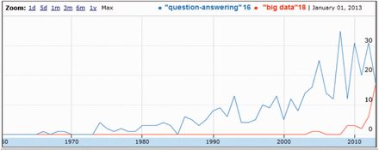
Figure 1. Evolution of the number of documents dealing with ‘QA’ in MEDLINE, compared with ‘Big Data’.
Notes:
Figure 1. Evolution of the number of documents dealing with ‘QA’ in MEDLINE, compared with ‘Big Data’.
Unless provided in the caption above, the following copyright applies to the content of this slide: © The Author(s) 2015. Published by Oxford University Press. This is an Open Access article distributed under the terms of the Creative Commons Attribution License ( http://creativecommons.org/licenses/by/4.0/ ), which permits unrestricted reuse, distribution, and reproduction in any medium, provided the original work is properly cited.

Slide 2
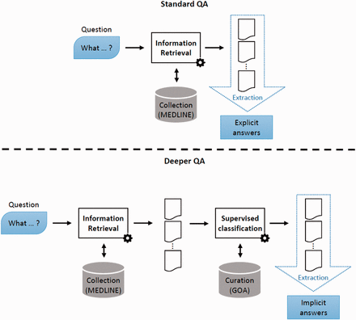
Figure 2. Deep QA. In standard QA, answers are extracted from some retrieved documents. In Deep QA, curated data are ...
Notes:
Figure 2. Deep QA. In standard QA, answers are extracted from some retrieved documents. In Deep QA, curated data are exploited to build a supervised classification model, which is then used to generate answers.
Unless provided in the caption above, the following copyright applies to the content of this slide: © The Author(s) 2015. Published by Oxford University Press. This is an Open Access article distributed under the terms of the Creative Commons Attribution License ( http://creativecommons.org/licenses/by/4.0/ ), which permits unrestricted reuse, distribution, and reproduction in any medium, provided the original work is properly cited.

Slide 3
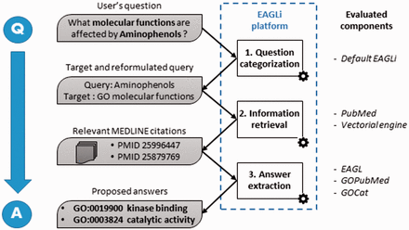
Figure 3. Overall workflow of the EAGLi platform. The input is a question formulated in natural language, the output is ...
Notes:
Figure 3. Overall workflow of the EAGLi platform. The input is a question formulated in natural language, the output is a set of candidate answers extracted from a set of retrieved MEDLINE abstracts.
Unless provided in the caption above, the following copyright applies to the content of this slide: © The Author(s) 2015. Published by Oxford University Press. This is an Open Access article distributed under the terms of the Creative Commons Attribution License ( http://creativecommons.org/licenses/by/4.0/ ), which permits unrestricted reuse, distribution, and reproduction in any medium, provided the original work is properly cited.

