Slide 1
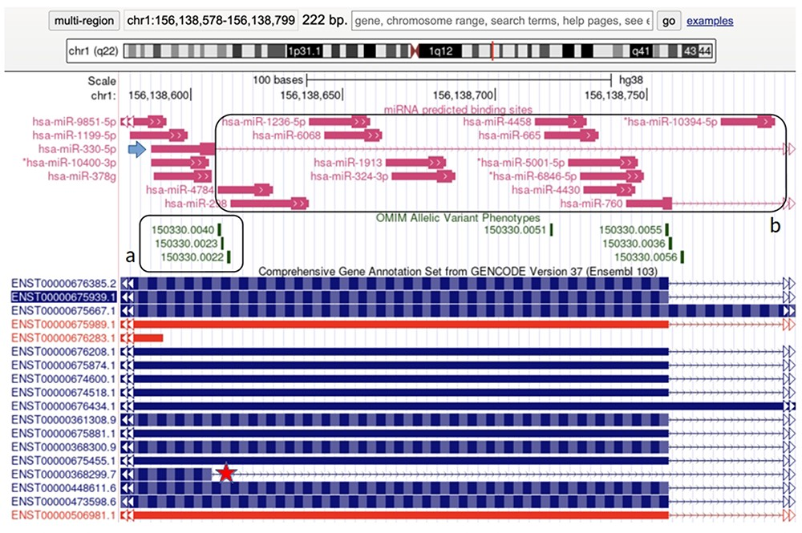
Figure 1. Visualization of a portion of the LMNA gene in UCSC genome browser (http://genome.ucsc.edu). (a) The vast ...
Notes:
Figure 1. Visualization of a portion of the LMNA gene in UCSC genome browser (http://genome.ucsc.edu). (a) The vast majority of the causative mutations for HGPS cluster in this splicing junction. The star points out the ENST00000368299 transcript, the LMNA splicing form lacking 150 nucleotides, typical of HGPS. The arrow points out the BS predicted for hsa-miR-330-5p which binds specifically the aberrant splicing form involved in HGPS only. (b) miRNAs that do not recognize the aberrant splicing form involved in HGPS.
Unless provided in the caption above, the following copyright applies to the content of this slide: © The Author(s) 2023. Published by Oxford University Press.This is an Open Access article distributed under the terms of the Creative Commons Attribution License (https://creativecommons.org/licenses/by/4.0/), which permits unrestricted reuse, distribution, and reproduction in any medium, provided the original work is properly cited.

Slide 2
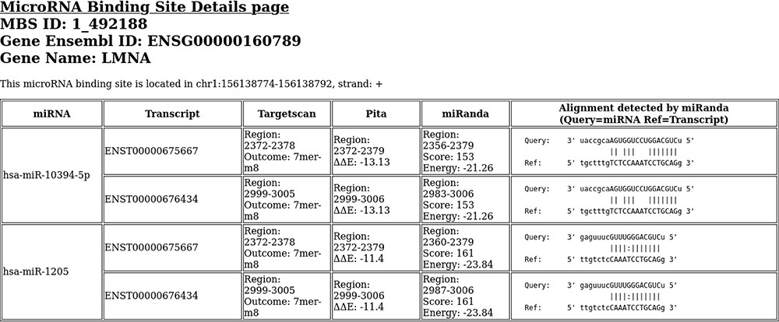
Figure 2. An example of binding site details html page. This binding site is located in LMNA gene.
Notes:
Figure 2. An example of binding site details html page. This binding site is located in LMNA gene.
Unless provided in the caption above, the following copyright applies to the content of this slide: © The Author(s) 2023. Published by Oxford University Press.This is an Open Access article distributed under the terms of the Creative Commons Attribution License (https://creativecommons.org/licenses/by/4.0/), which permits unrestricted reuse, distribution, and reproduction in any medium, provided the original work is properly cited.

