Slide 1
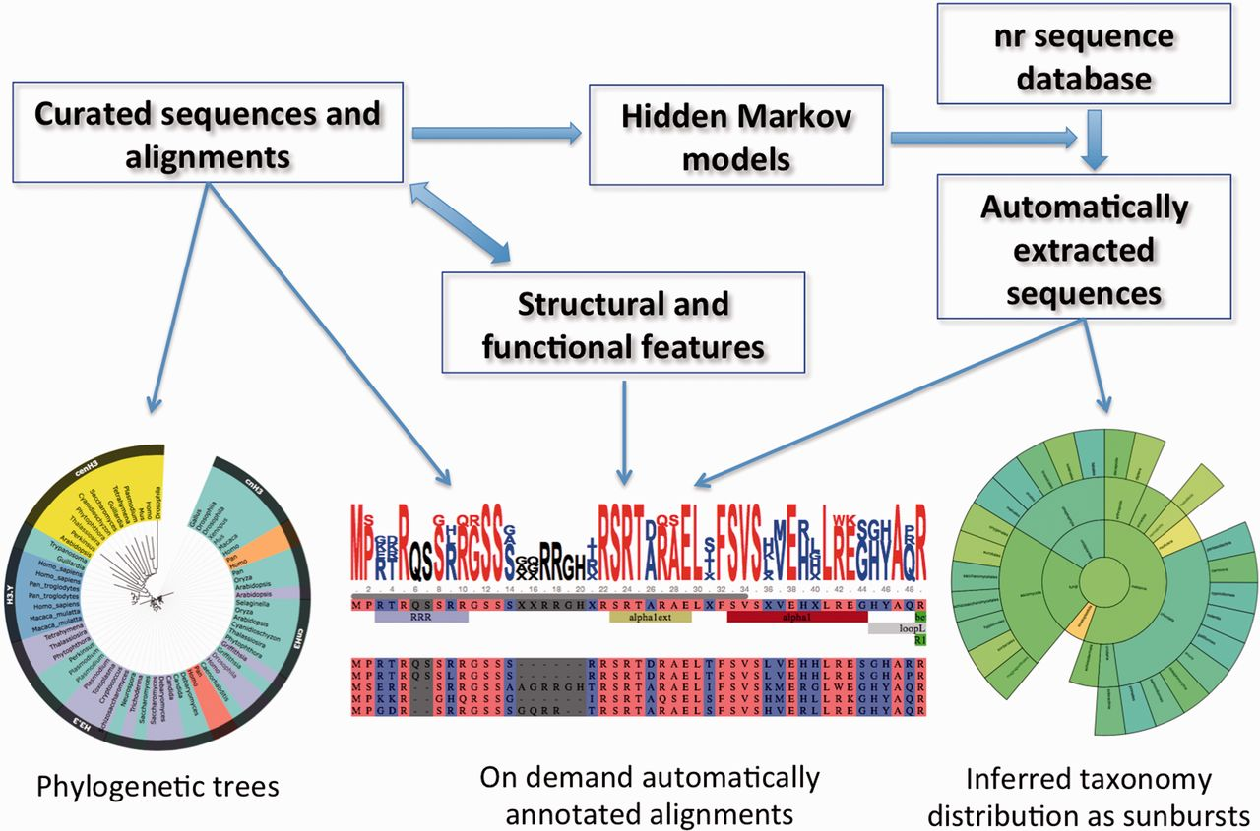
Figure 2. Information flow, main data types and widgets in HistoneDB 2.0 (see text for description).
Notes:
Figure 2. Information flow, main data types and widgets in HistoneDB 2.0 (see text for description).
Unless provided in the caption above, the following copyright applies to the content of this slide: Published by Oxford University Press 2015. This work is written by US Government employees and is in the public domain in the United States.

