Slide 1
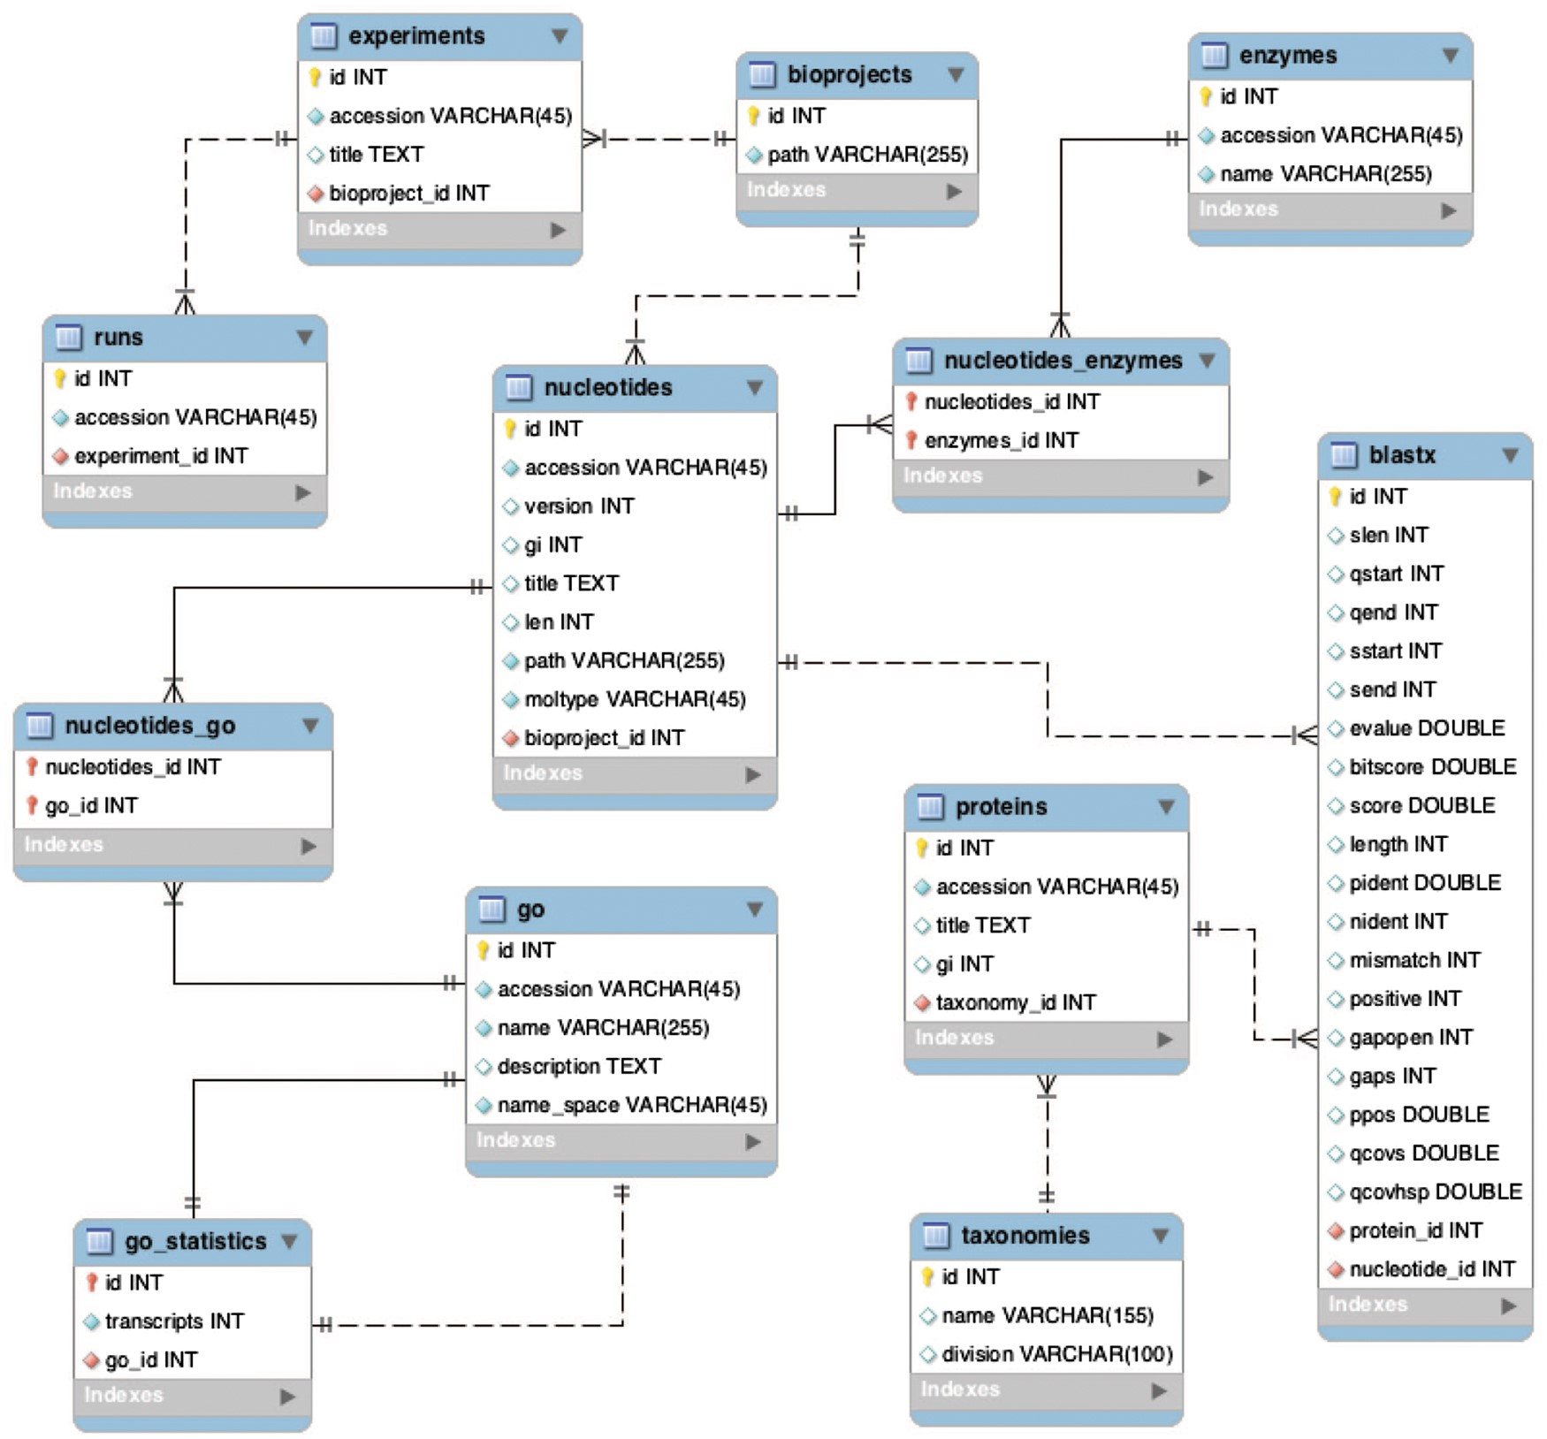
Figure 6. Backend database schema developed to store multiple BioProjects.
Notes:
Figure 6. Backend database schema developed to store multiple BioProjects.
Unless provided in the caption above, the following copyright applies to the content of this slide: Published by Oxford University Press 2017. This work is written by US Government employees and is in the public domain in the US.

