Slide 1
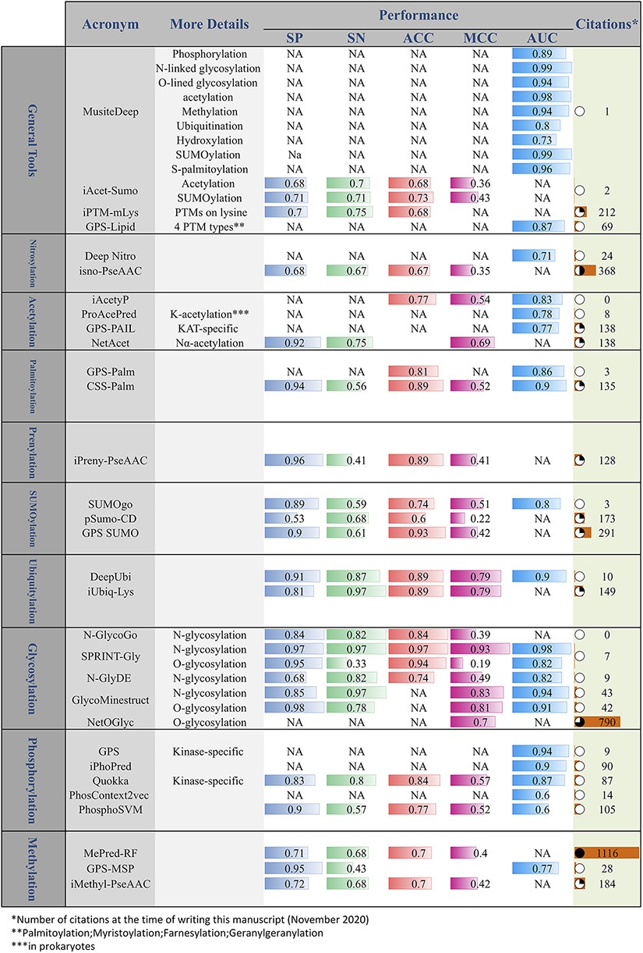
Figure 7. Online PTM prediction tools. The values of five important performance assessment measures have been extracted ...
Notes:
Figure 7. Online PTM prediction tools. The values of five important performance assessment measures have been extracted from the related publications: specificity (SP), sensitivity (SN), accuracy (ACC), Matthews’s correlation coefficient (MCC) and area under the ROC curve (AUC).
Unless provided in the caption above, the following copyright applies to the content of this slide: © The Author(s) 2021. Published by Oxford University Press. All rights reserved. For permissions, please e-mail: journals.permissions@oup.comThis article is published and distributed under the terms of the Oxford University Press, Standard Journals Publication Model (https://academic.oup.com/journals/pages/open_access/funder_policies/chorus/standard_publication_model)

