Slide 1
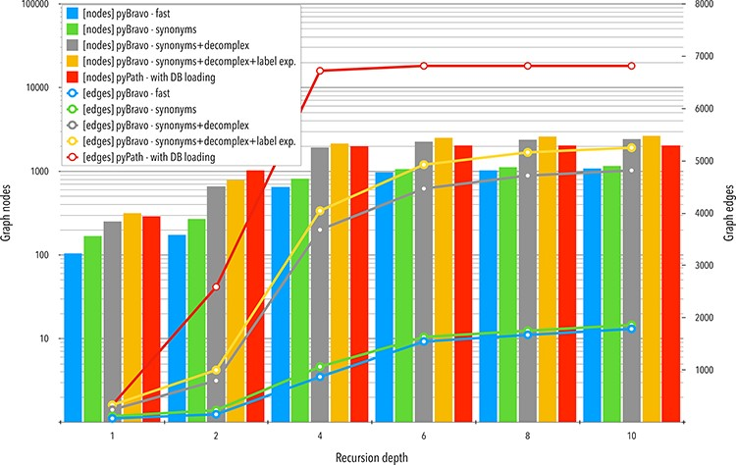
Figure 3. Comparative analyses of the networks obtained with pyBRAvo and PyPath. The horizontal axis represents the ...
Notes:
Figure 3. Comparative analyses of the networks obtained with pyBRAvo and PyPath. The horizontal axis represents the level of reconstruction depth of the SN. Bars plot show measures of the number of nodes; lines show the number of edges, the y-axis (left) is shown in a logarithmic scale.
Unless provided in the caption above, the following copyright applies to the content of this slide: © The Author(s) 2021. Published by Oxford University Press.This is an Open Access article distributed under the terms of the Creative Commons Attribution License (http://creativecommons.org/licenses/by/4.0/), which permits unrestricted reuse, distribution, and reproduction in any medium, provided the original work is properly cited.

