Slide 1
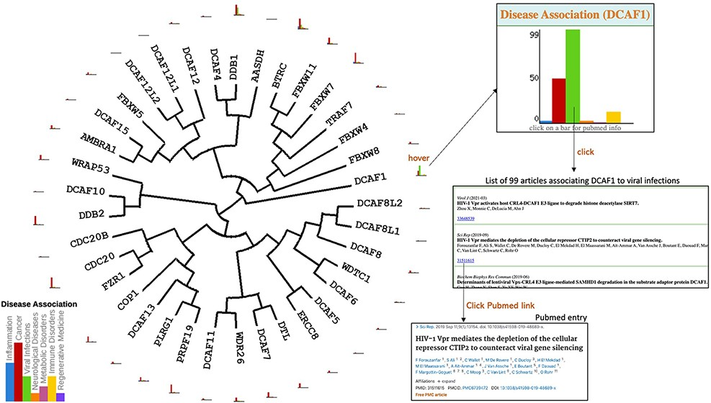
Figure 2. Disease association. Evolutionary dendograms for any table (Figure 1) are automatically generated, onto which ...
Notes:
Figure 2. Disease association. Evolutionary dendograms for any table (Figure 1) are automatically generated, onto which data can be projected. Here, histograms representing the number of articles indexed in PubMed linking each gene to specific disease areas are shown. Hovering over histogram icons opens larger bar charts where bars can be clicked to produce the list of articles, each linked to their respective PubMed entry.
Unless provided in the caption above, the following copyright applies to the content of this slide: © The Author(s) 2022. Published by Oxford University Press.This is an Open Access article distributed under the terms of the Creative Commons Attribution-NonCommercial License (https://creativecommons.org/licenses/by-nc/4.0/), which permits non-commercial re-use, distribution, and reproduction in any medium, provided the original work is properly cited. For commercial re-use, please contact journals.permissions@oup.com

