Slide 1
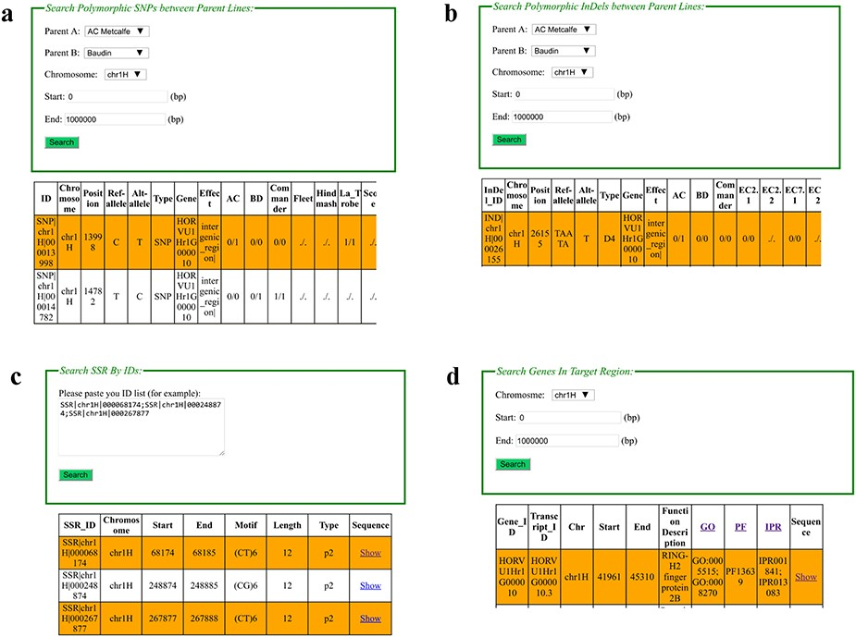
Figure 2. Web interfaces of retrieving SNPs, InDels, SSRs and gene annotation in BarleyVarDB. (a) Main interface of SNP ...
Notes:
Figure 2. Web interfaces of retrieving SNPs, InDels, SSRs and gene annotation in BarleyVarDB. (a) Main interface of SNP search input and result output. (b) Main interface of InDel search input and result output. (c) Main interface of SSRs search input and result output. (d) Main interface of gene annotation search input and result output.
Unless provided in the caption above, the following copyright applies to the content of this slide: © The Author(s) 2020. Published by Oxford University Press.This is an Open Access article distributed under the terms of the Creative Commons Attribution License (http://creativecommons.org/licenses/by/4.0/), which permits unrestricted reuse, distribution, and reproduction in any medium, provided the original work is properly cited.

