Slide 1
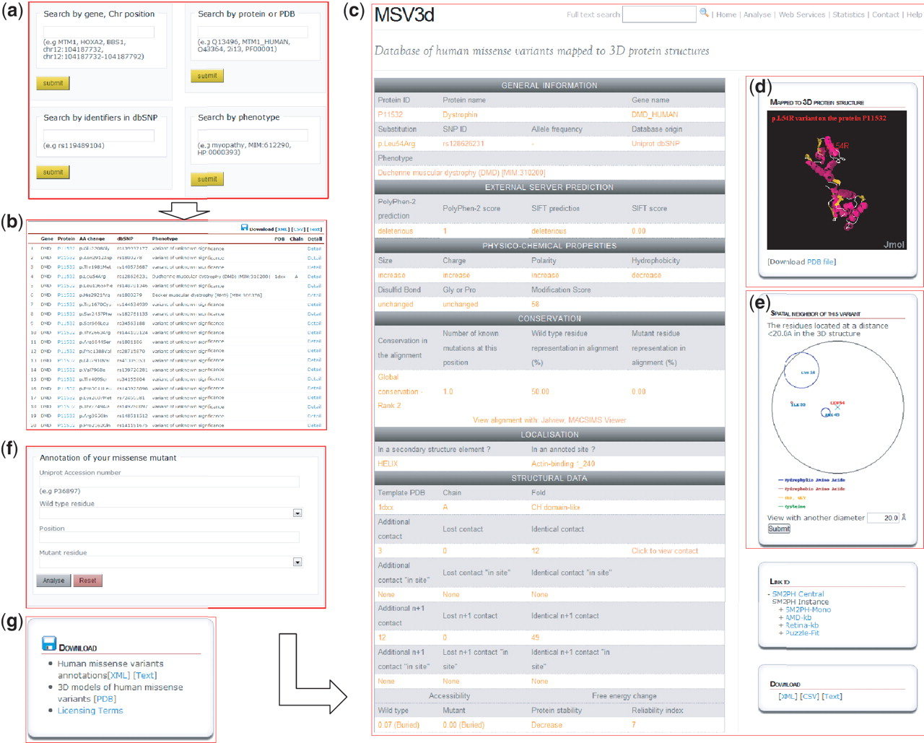
Figure 3 MSV3d web interface contains numerous functionalities including: (a) field search, (b) free text search, (c) ...
Notes:
Figure 3 MSV3d web interface contains numerous functionalities including: (a) field search, (b) free text search, (c) detailed information, (d) 3D structure visualization using Jmol, (e) spatial neighbouring residue visualization, (f) missense annotation service and (g) download service.
Unless provided in the caption above, the following copyright applies to the content of this slide: © The Author(s) 2012. Published by Oxford University Press.This is an Open Access article distributed under the terms of the Creative Commons Attribution Non-Commercial License (http://creativecommons.org/licenses/by-nc/3.0), which permits unrestricted non-commercial use, distribution, and reproduction in any medium, provided the original work is properly cited.

Slide 2
Figure 2 Histogram showing distributions of missense variants by SCOP fold. Each bar contains two parts: the red part ...
Notes:
Figure 2 Histogram showing distributions of missense variants by SCOP fold. Each bar contains two parts: the red part represents deleterious substitutions and the green part represents tolerated substitutions.
Unless provided in the caption above, the following copyright applies to the content of this slide: © The Author(s) 2012. Published by Oxford University Press.This is an Open Access article distributed under the terms of the Creative Commons Attribution Non-Commercial License (http://creativecommons.org/licenses/by-nc/3.0), which permits unrestricted non-commercial use, distribution, and reproduction in any medium, provided the original work is properly cited.

Slide 3
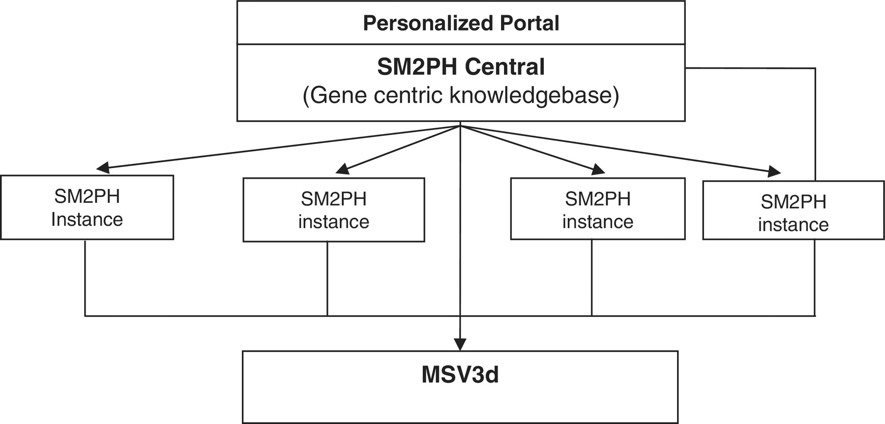
Figure 1 General architecture of SM2PH central. SM2PH Central allows the generation of SM2PH instances (focusing on ...
Notes:
Figure 1 General architecture of SM2PH central. SM2PH Central allows the generation of SM2PH instances (focusing on specific sets of target genes) which can access variant information through the new MSV3d, devoted to human variant data and information.
Unless provided in the caption above, the following copyright applies to the content of this slide: © The Author(s) 2012. Published by Oxford University Press.This is an Open Access article distributed under the terms of the Creative Commons Attribution Non-Commercial License (http://creativecommons.org/licenses/by-nc/3.0), which permits unrestricted non-commercial use, distribution, and reproduction in any medium, provided the original work is properly cited.

Slide 4
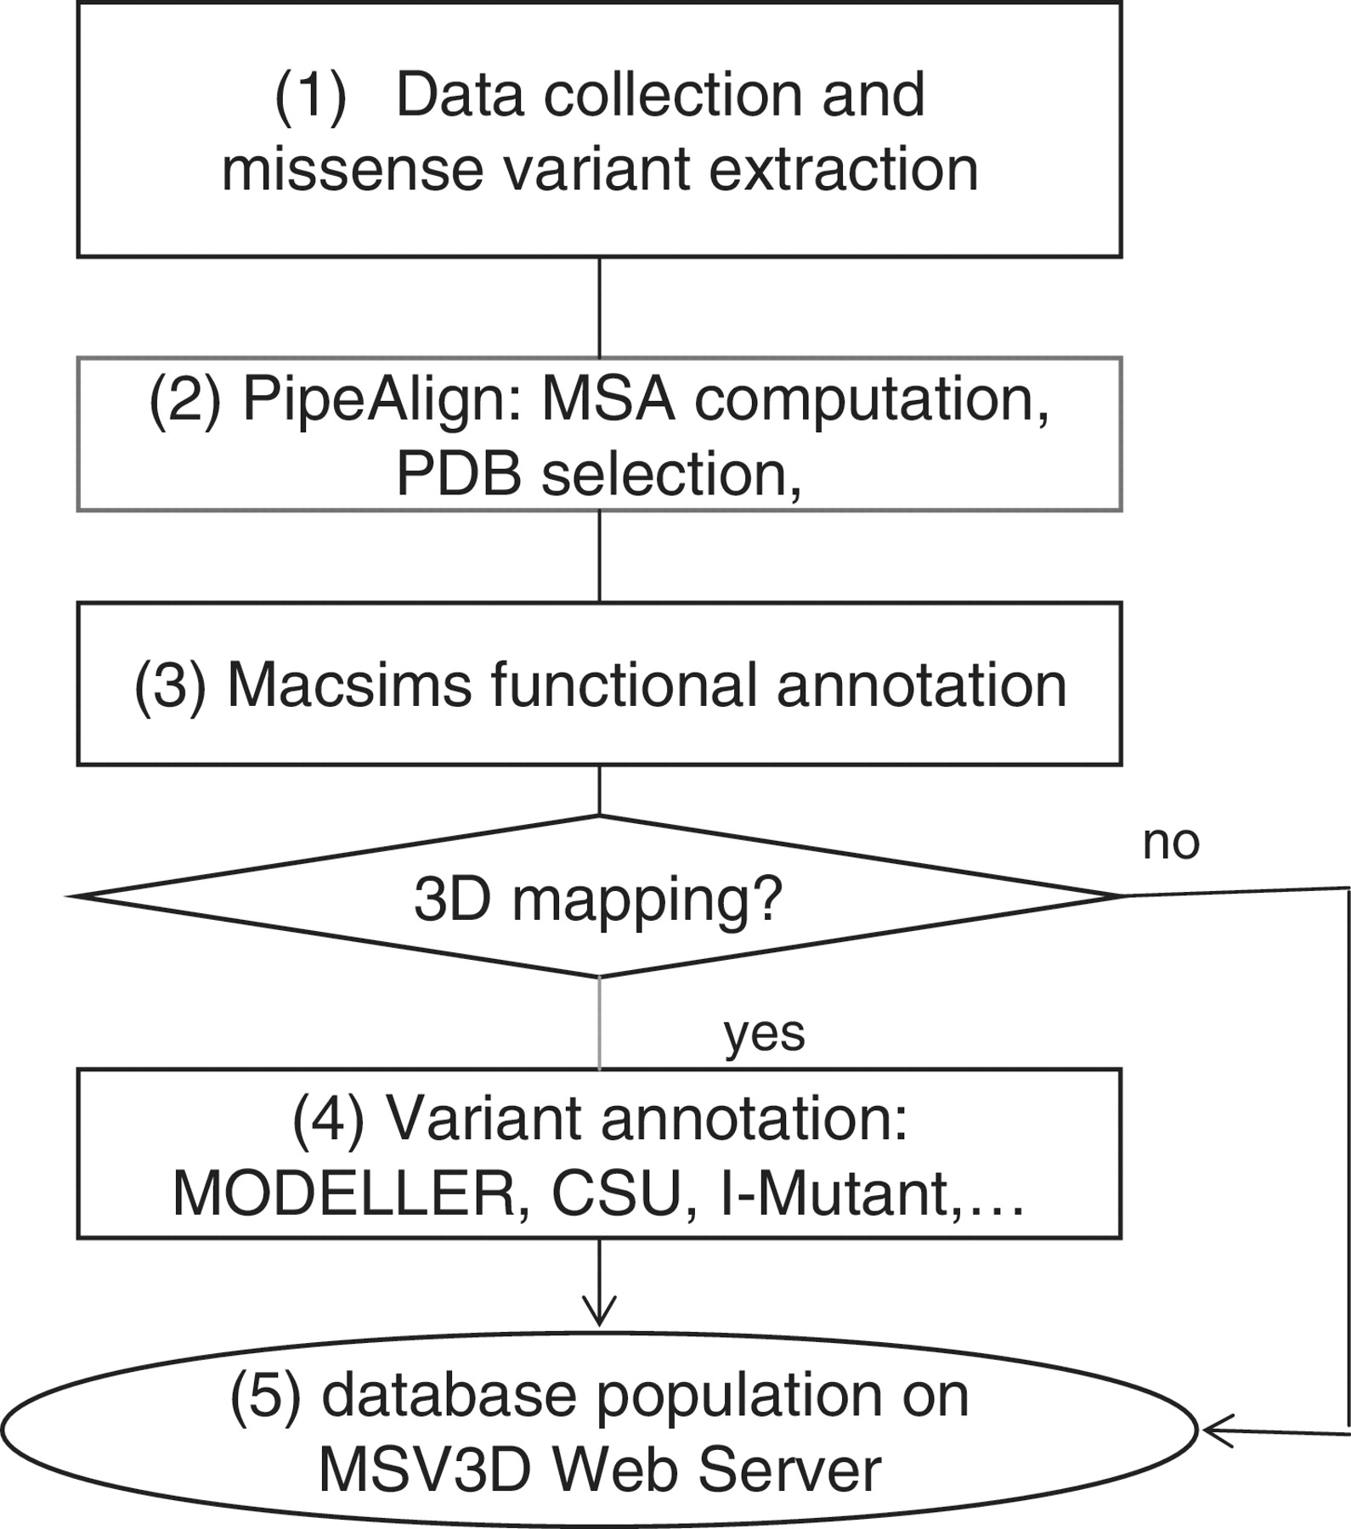
Figure 4 Schema of software pipeline.
Notes:
Figure 4 Schema of software pipeline.
Unless provided in the caption above, the following copyright applies to the content of this slide: © The Author(s) 2012. Published by Oxford University Press.This is an Open Access article distributed under the terms of the Creative Commons Attribution Non-Commercial License (http://creativecommons.org/licenses/by-nc/3.0), which permits unrestricted non-commercial use, distribution, and reproduction in any medium, provided the original work is properly cited.

