Slide 1
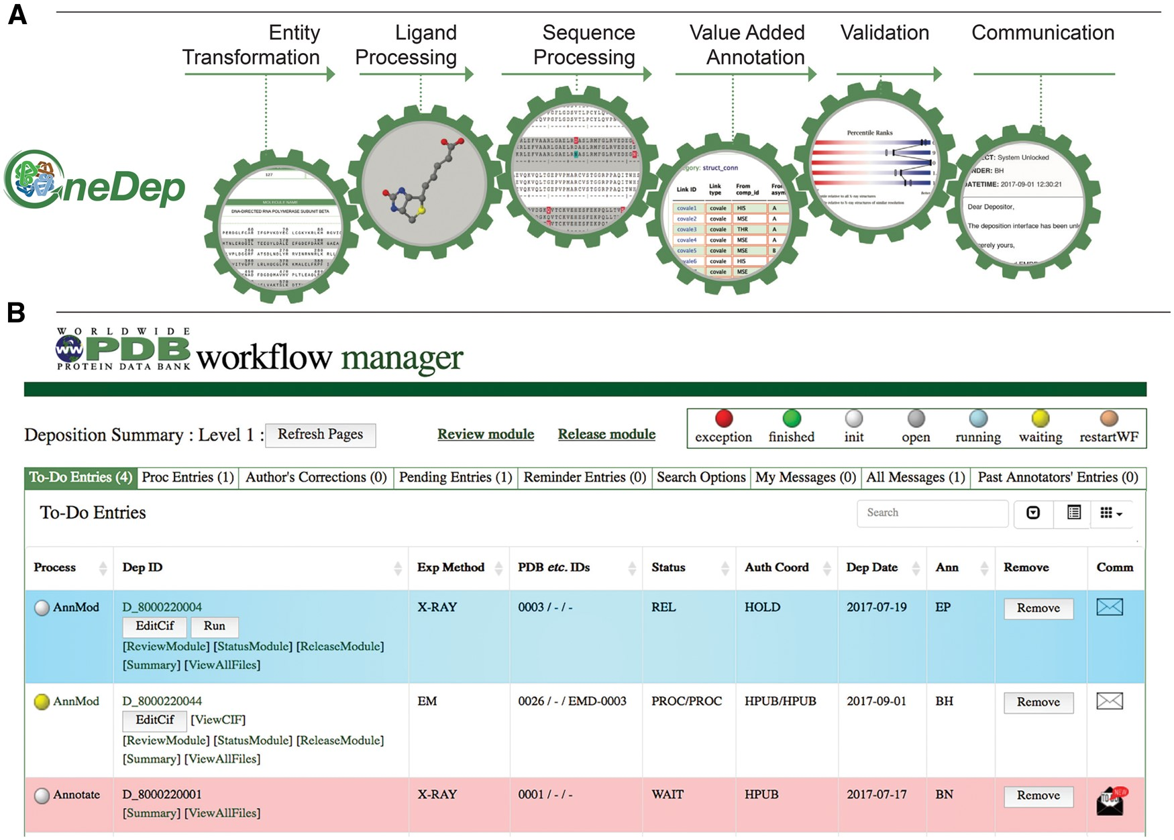
Figure 2. Major modules controlled by the workflow and WFM. (A) Mandatory major tasks controlled by the workflow with a ...
Notes:
Figure 2. Major modules controlled by the workflow and WFM. (A) Mandatory major tasks controlled by the workflow with a pre-defined order. (B) WFM interface that allows Biocurators to prioritize their tasks, to manage multiple entries and to access module user interface for manual biocuration after completion of automated calculations.
Unless provided in the caption above, the following copyright applies to the content of this slide: © The Author(s) 2018. Published by Oxford University Press.This is an Open Access article distributed under the terms of the Creative Commons Attribution License (http://creativecommons.org/licenses/by/4.0/), which permits unrestricted reuse, distribution, and reproduction in any medium, provided the original work is properly cited.

