Slide 1
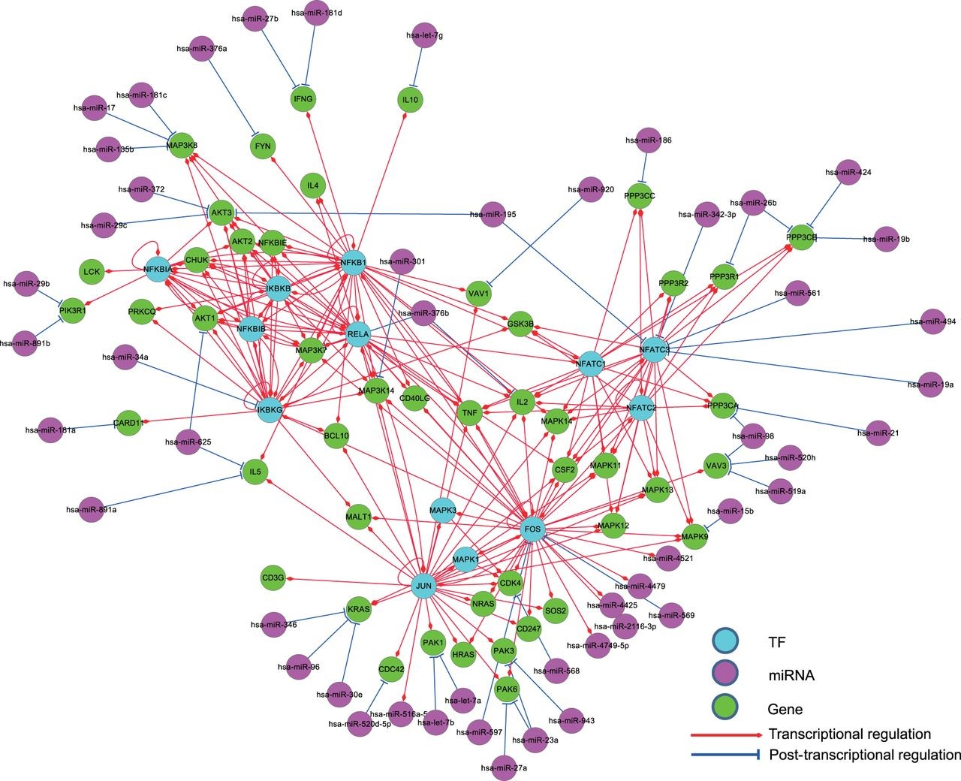
Figure 6. The regulatory relationships of a KEGG gene set for the human T cell receptor signaling pathway in ...
Notes:
Figure 6. The regulatory relationships of a KEGG gene set for the human T cell receptor signaling pathway in RegNetwork. TF, miRNA and gene are in different colors and the transcriptional and post-transcriptional interplays are shown in red and blue, respectively.
Unless provided in the caption above, the following copyright applies to the content of this slide: © The Author(s) 2015. Published by Oxford University Press. This is an Open Access article distributed under the terms of the Creative Commons Attribution License ( http://creativecommons.org/licenses/by/4.0/ ), which permits unrestricted reuse, distribution, and reproduction in any medium, provided the original work is properly cited.

