Slide 1
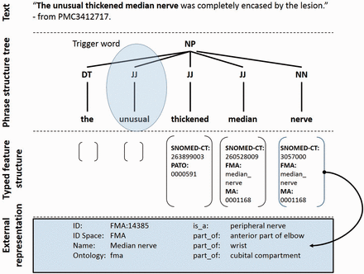
Figure 2. Semantic representation of a text fragment in the PhenoMiner system. Keyword search identifies the potential ...
Notes:
Figure 2. Semantic representation of a text fragment in the PhenoMiner system. Keyword search identifies the potential trigger word unusual causing the sentence to be selected for grammatical parsing. The adjectives thickened and median along with the common noun nerve are identified and their corresponding ontology terms are mapped as shown. A semantically typed regular expression then guides the system to select the phrase as a phenotype candidate.
Unless provided in the caption above, the following copyright applies to the content of this slide: © The Author(s) 2015. Published by Oxford University Press. This is an Open Access article distributed under the terms of the Creative Commons Attribution License ( http://creativecommons.org/licenses/by/4.0/ ), which permits unrestricted reuse, distribution, and reproduction in any medium, provided the original work is properly cited.

