Slide 1
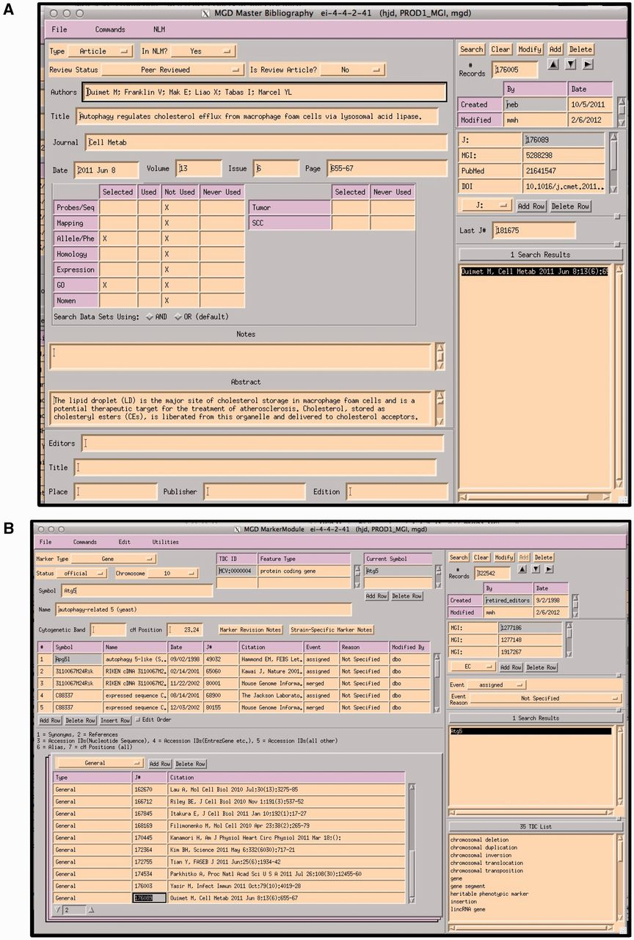
Figure 3. (A) MGI Master Bib EI, showing a record for a paper that has been selected for alleles/phenotypes and GO. The ...
Notes:
Figure 3. (A) MGI Master Bib EI, showing a record for a paper that has been selected for alleles/phenotypes and GO. The paper has not yet been curated for GO (indicated by an X in the selected and X in Not Used). (B) MGI Gene Feature Detail Module. References to be associated with this gene are entered into the lower left hand panel. If a paper is associated with multiple genes, the same paper is entered for each gene. All EIs are TeleUSE graphical user interface applications running under X-windows.
Unless provided in the caption above, the following copyright applies to the content of this slide: © The Author(s) 2012. Published by Oxford University Press.This is an Open Access article distributed under the terms of the Creative Commons Attribution License (http://creativecommons.org/licenses/by-nc/3.0/), which permits non-commercial reuse, distribution, and reproduction in any medium, provided the original work is properly cited. For commercial re-use, please contact journals.permissions@oup.com.

