Slide 1
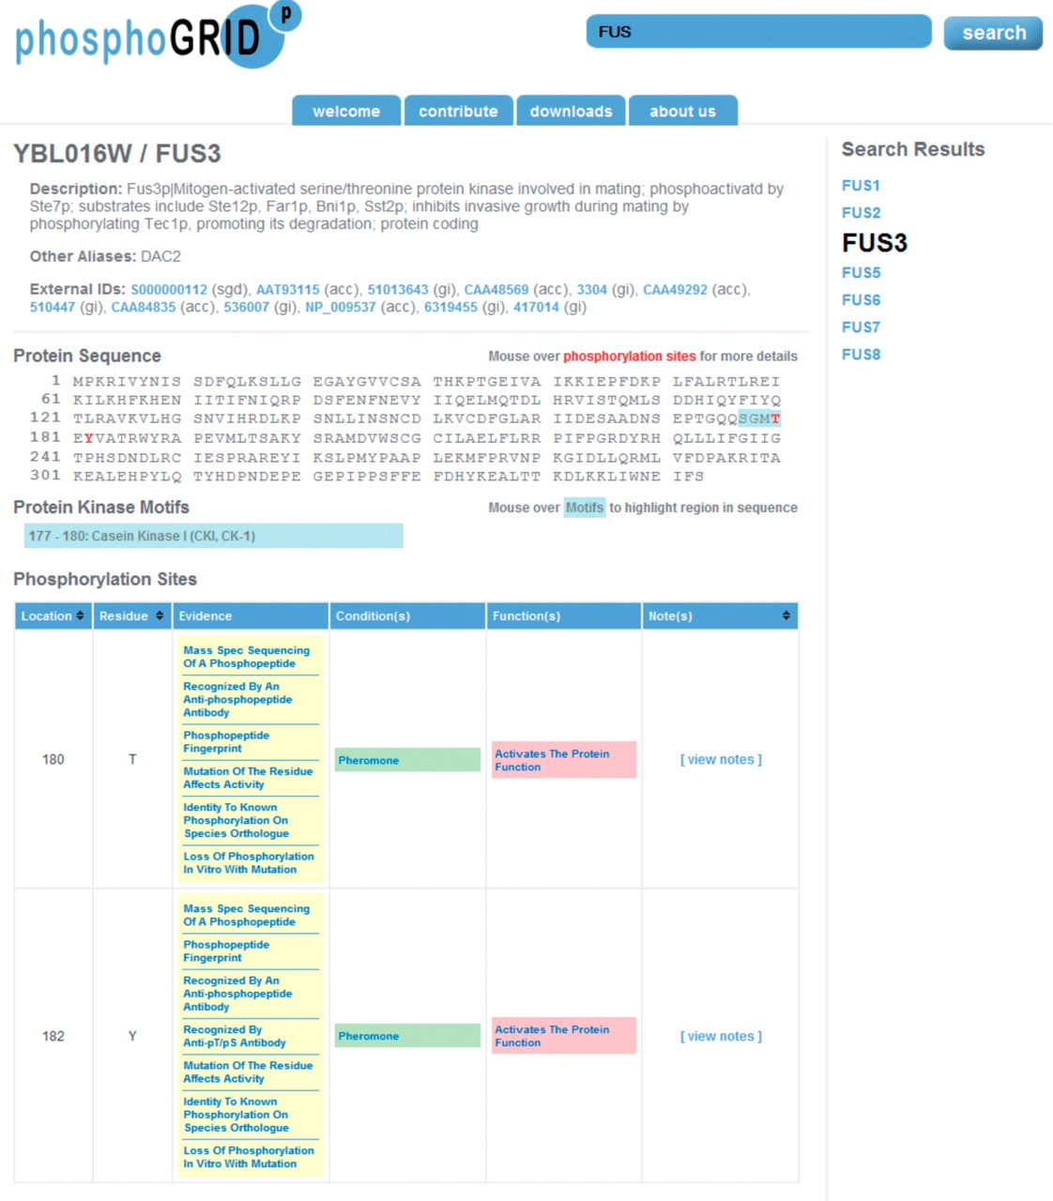
Figure 1. Screen shot of PhosphoGRID webpage produced by a search for the mating pheromone MAPK Fus3. Phosphorylated ...
Notes:
Figure 1. Screen shot of PhosphoGRID webpage produced by a search for the mating pheromone MAPK Fus3. Phosphorylated amino acids are indicated on the protein sequence in red. Consensus sites for known protein kinases overlapping phosphosites are indicated in blue. Detailed information relating to each identified phosphosite is presented in table form below, with links to PubMED references for the evidence of phosphorylation, conditions under which phosphorylation occurs and effects on protein function.
Unless provided in the caption above, the following copyright applies to the content of this slide: © The Author(s) 2010. Published by Oxford University Press.This is Open Access article distributed under the terms of the Creative Commons Attribution Non-Commercial License (http://creativecommons.org/licenses/by-nc/2.5), which permits unrestricted non-commercial use, distribution, and reproduction in any medium, provided the original work is properly cited.

Slide 2
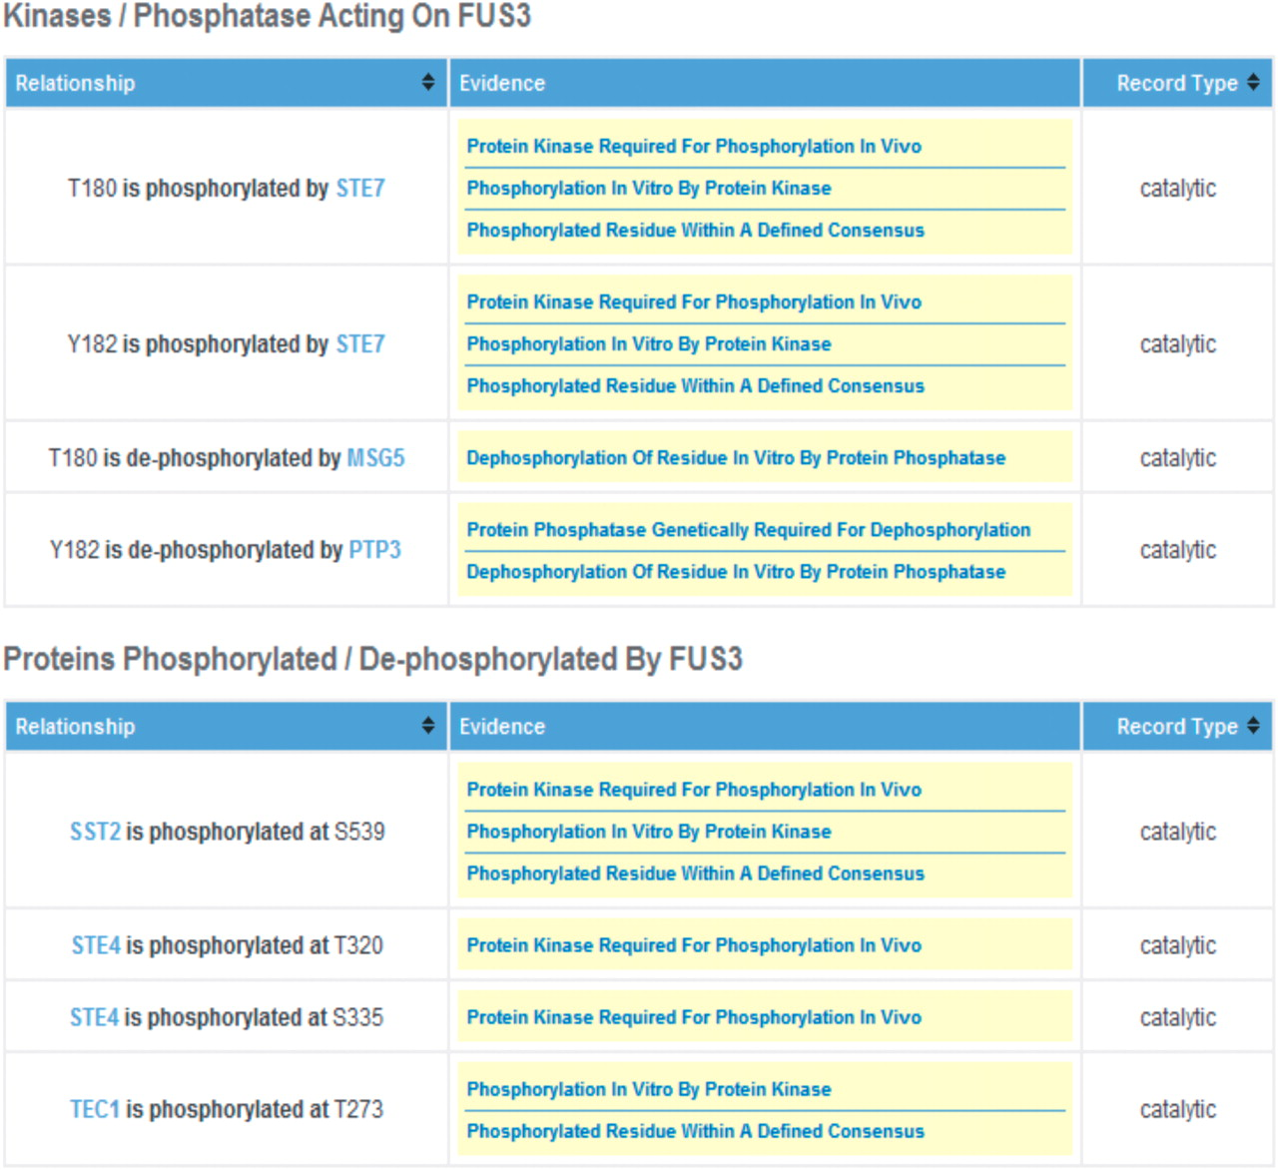
Figure 2. Screen shot of the Fus3 PhosphoGRID page. Details of relationships between phosphorylated residues and ...
Notes:
Figure 2. Screen shot of the Fus3 PhosphoGRID page. Details of relationships between phosphorylated residues and specific protein kinases and phosphatases are displayed in a second table for each gene product. Additionally, for protein kinases and phosphatases themselves, a summary of known substrate sites, with links to the relevant gene product is presented in an additional table (not shown).
Unless provided in the caption above, the following copyright applies to the content of this slide: © The Author(s) 2010. Published by Oxford University Press.This is Open Access article distributed under the terms of the Creative Commons Attribution Non-Commercial License (http://creativecommons.org/licenses/by-nc/2.5), which permits unrestricted non-commercial use, distribution, and reproduction in any medium, provided the original work is properly cited.

Slide 3
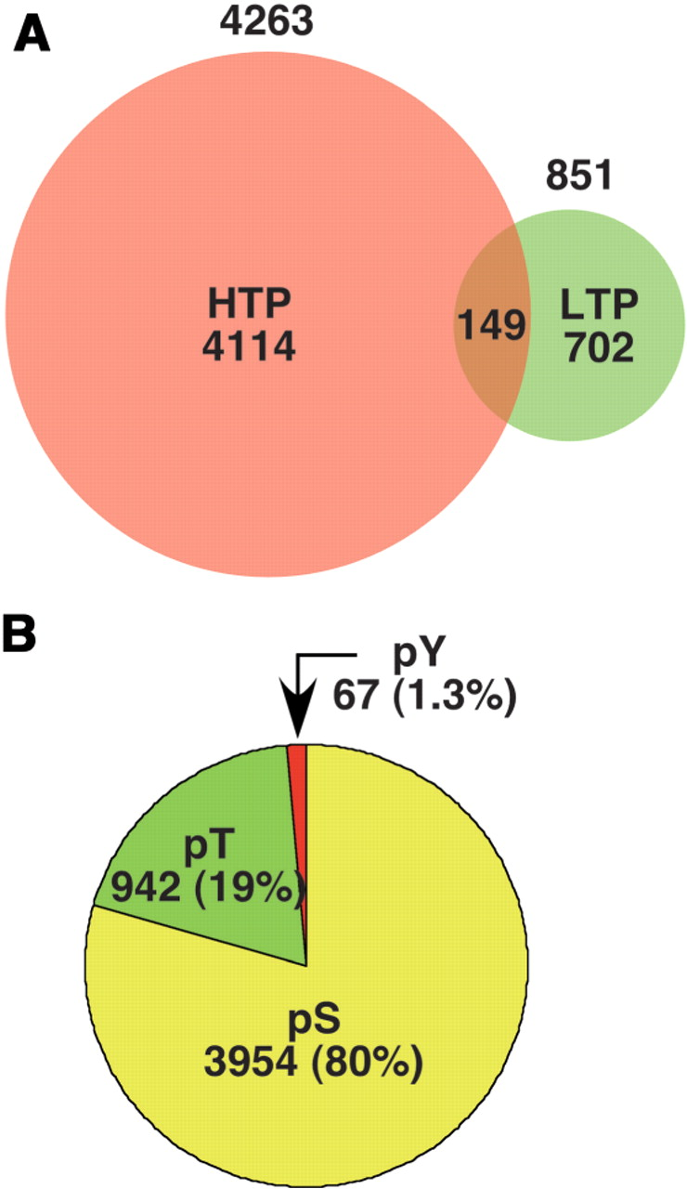
Figure 3. (A). The number of individual phosphorylation sites listed in PhosphoGRID version 1.0 identified by HTP mass ...
Notes:
Figure 3. (A). The number of individual phosphorylation sites listed in PhosphoGRID version 1.0 identified by HTP mass spectrometry-based studies (red) and focused LTP studies on individual proteins (green). (B). The proportion of PhosphoGRID entries representing phosphoserine, phosphothreonine and phosphotyrosine residues.
Unless provided in the caption above, the following copyright applies to the content of this slide: © The Author(s) 2010. Published by Oxford University Press.This is Open Access article distributed under the terms of the Creative Commons Attribution Non-Commercial License (http://creativecommons.org/licenses/by-nc/2.5), which permits unrestricted non-commercial use, distribution, and reproduction in any medium, provided the original work is properly cited.

Slide 4
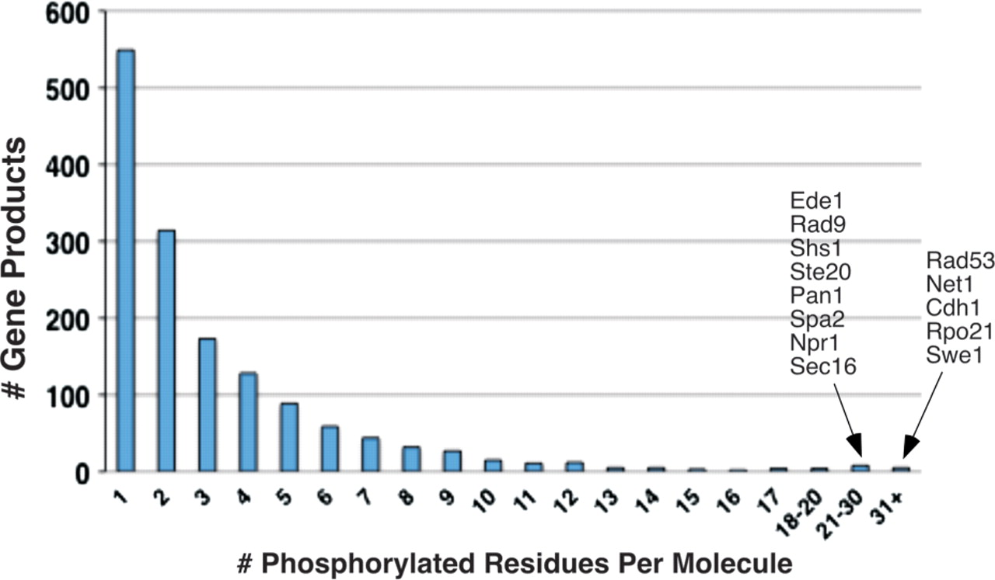
Figure 4. Distribution of multiply phosphorylated proteins in PhosphoGRID. The number of proteins with the indicated ...
Notes:
Figure 4. Distribution of multiply phosphorylated proteins in PhosphoGRID. The number of proteins with the indicated phosphorylated residues in PhosphoGRID are shown. The identity of gene products with 21 or greater identified phosphorylations are indicated to the right.
Unless provided in the caption above, the following copyright applies to the content of this slide: © The Author(s) 2010. Published by Oxford University Press.This is Open Access article distributed under the terms of the Creative Commons Attribution Non-Commercial License (http://creativecommons.org/licenses/by-nc/2.5), which permits unrestricted non-commercial use, distribution, and reproduction in any medium, provided the original work is properly cited.

Slide 5
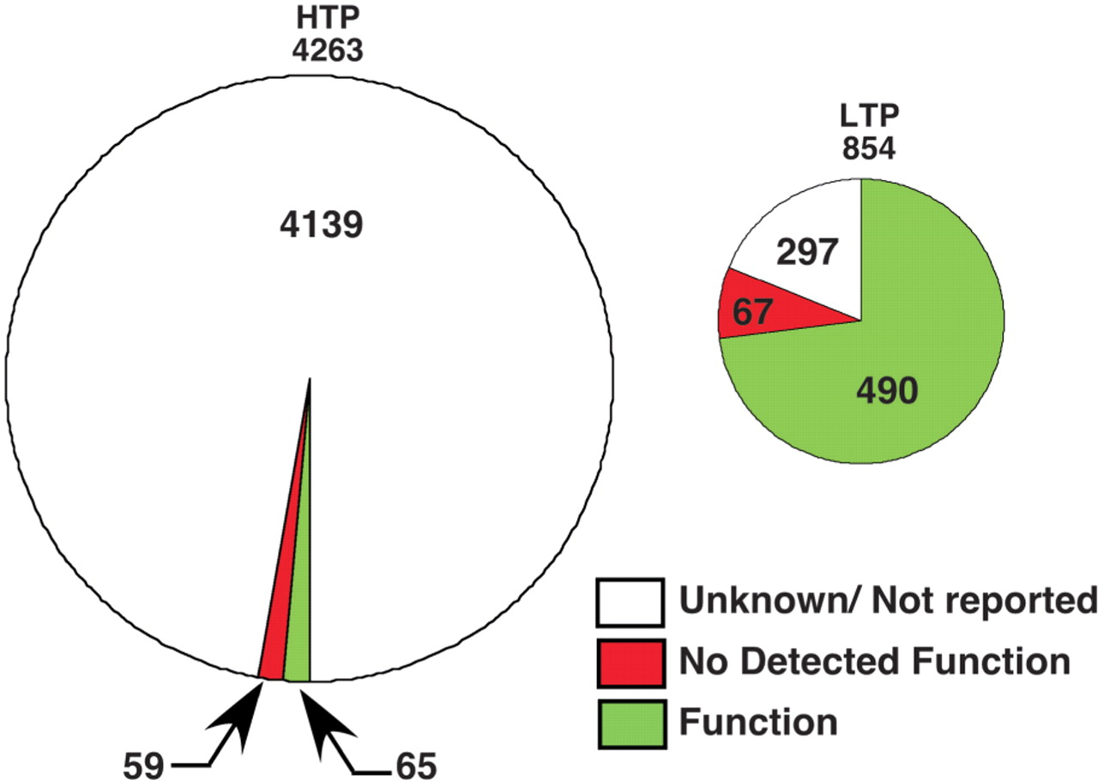
Figure 5. Proportion of phosphorylation sites in PhosphoGRID with defined functions. Summaries of phosphorylation sites ...
Notes:
Figure 5. Proportion of phosphorylation sites in PhosphoGRID with defined functions. Summaries of phosphorylation sites identified by HTP mass spectrometry-based studies (left chart) or focused LTP studies on individual proteins (right chart) are shown.
Unless provided in the caption above, the following copyright applies to the content of this slide: © The Author(s) 2010. Published by Oxford University Press.This is Open Access article distributed under the terms of the Creative Commons Attribution Non-Commercial License (http://creativecommons.org/licenses/by-nc/2.5), which permits unrestricted non-commercial use, distribution, and reproduction in any medium, provided the original work is properly cited.

