Slide 1
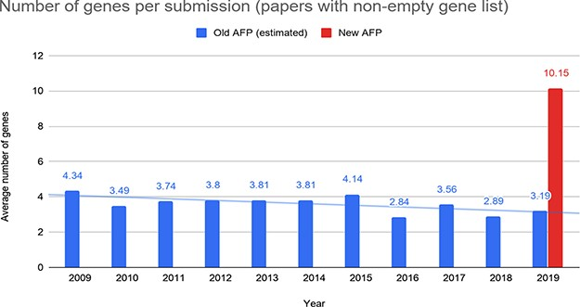
Figure 10 Number of genes reported by the authors per submission through the old and the new AFP forms.
Notes:
Figure 10 Number of genes reported by the authors per submission through the old and the new AFP forms.
Unless provided in the caption above, the following copyright applies to the content of this slide: © The Author(s) 2020. Published by Oxford University Press.This is an Open Access article distributed under the terms of the Creative Commons Attribution License (http://creativecommons.org/licenses/by/4.0/), which permits unrestricted reuse, distribution, and reproduction in any medium, provided the original work is properly cited.

