Slide 1
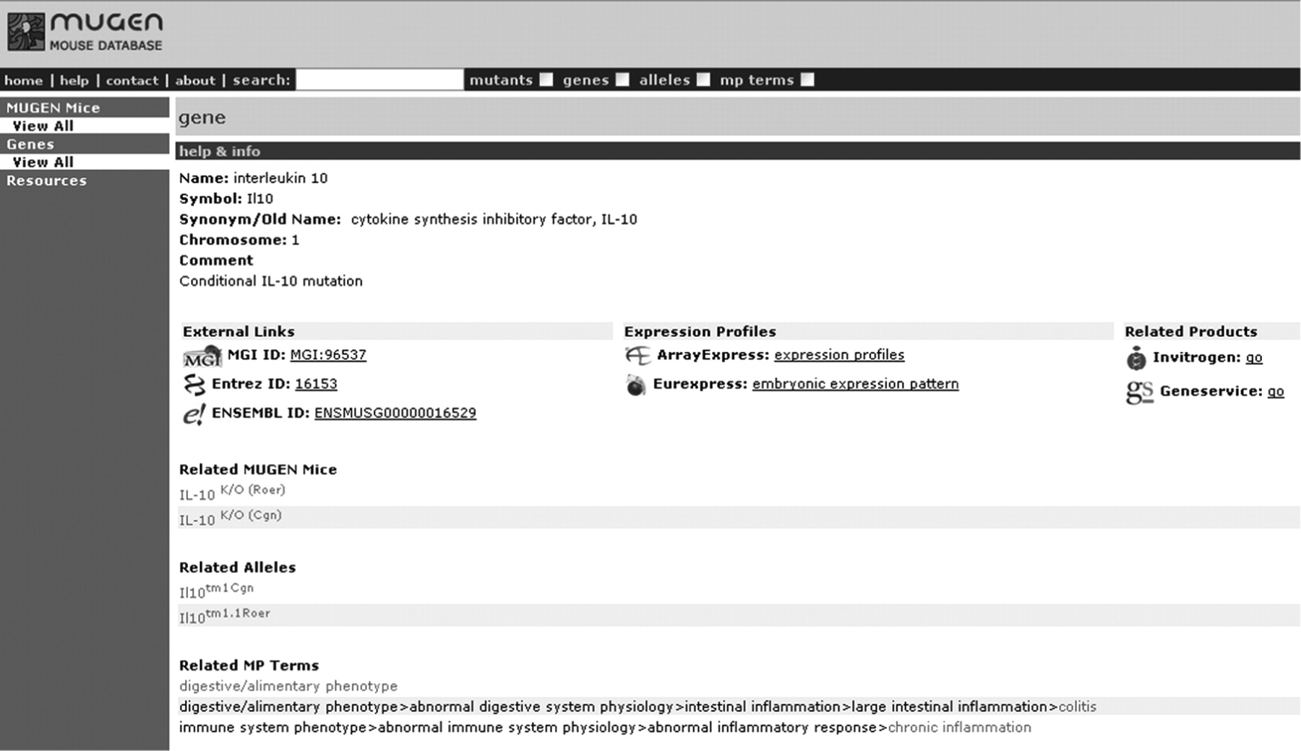
Figure 1. Sample screen shot of MMdb ‘IL-10’ gene with the direct trial links, under the gene information, to ...
Notes:
Figure 1. Sample screen shot of MMdb ‘IL-10’ gene with the direct trial links, under the gene information, to Invitrogen and Geneservice through the gene ID.
Unless provided in the caption above, the following copyright applies to the content of this slide: © The Author(s) 2009. Published by Oxford University Press.This is Open Access article distributed under the terms of the Creative Commons Attribution Non-Commercial License (http://creativecommons.org/licenses/by-nc/2.5/uk/) which permits unrestricted non-commercial use, distribution, and reproduction in any medium, provided the original work is properly cited.

