Slide 1
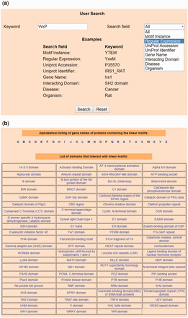
Figure 2. Snapshots of search and browse option of LMPID. ( a ) Search’ page of LMPID showing ‘WxP’ used as a keyword ...
Notes:
Figure 2. Snapshots of search and browse option of LMPID. ( a ) Search’ page of LMPID showing ‘WxP’ used as a keyword to be searched in the ‘Regular Expression’ field. ( b ) ‘Browse’ page of LMPID.
Unless provided in the caption above, the following copyright applies to the content of this slide: © The Author(s) 2015. Published by Oxford University Press.This is an Open Access article distributed under the terms of the Creative Commons Attribution License (http://creativecommons.org/licenses/by/4.0/), which permits unrestricted reuse, distribution, and reproduction in any medium, provided the original work is properly cited.

