Slide 1
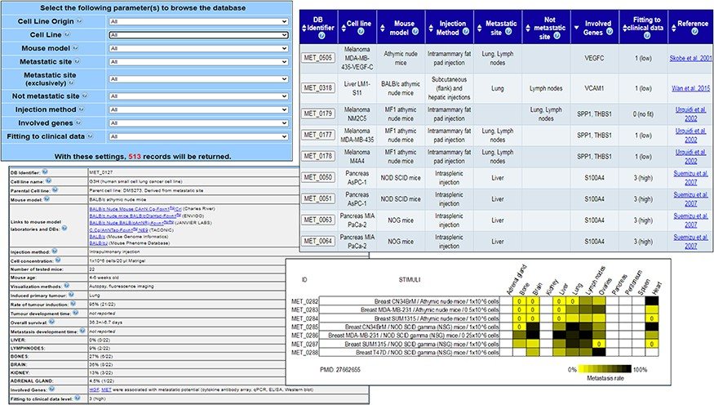
Figure 1. MetaTropismDB web interfaces. At the top, left: the Browse page which allows the selection of search ...
Notes:
Figure 1. MetaTropismDB web interfaces. At the top, left: the Browse page which allows the selection of search parameters. At the top, right: search result page showing the synthetic information of each experiment. At the bottom, left: card with full details of each experiment. At the bottom, right: an image at the bottom of each card shows the metastasis patterns as a result of different experimental conditions assessed in the same study.
Unless provided in the caption above, the following copyright applies to the content of this slide: © The Author(s) 2020. Published by Oxford University Press.This is an Open Access article distributed under the terms of the Creative Commons Attribution License (http://creativecommons.org/licenses/by/4.0/), which permits unrestricted reuse, distribution, and reproduction in any medium, provided the original work is properly cited.

