Slide 1
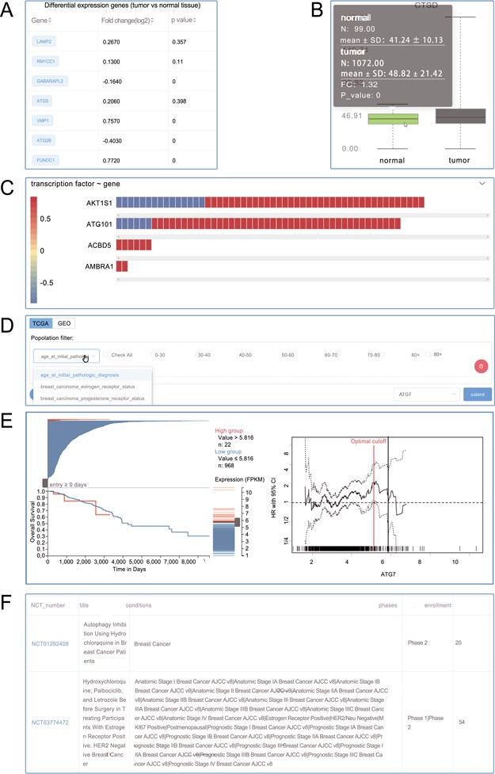
Figure 3 Screenshots from the Autophagy in Tumors. (A) Differential expression analysis; (B) box plot; (C) heat plot; ...
Notes:
Figure 3 Screenshots from the Autophagy in Tumors. (A) Differential expression analysis; (B) box plot; (C) heat plot; (D) population filter for customized survival analysis; (E) interactive Kaplan–Meier plotter interface; (F) clinical trials.
Unless provided in the caption above, the following copyright applies to the content of this slide: © The Author(s) 2020. Published by Oxford University Press.This is an Open Access article distributed under the terms of the Creative Commons Attribution License (http://creativecommons.org/licenses/by/4.0/), which permits unrestricted reuse, distribution, and reproduction in any medium, provided the original work is properly cited.

