Slide 1
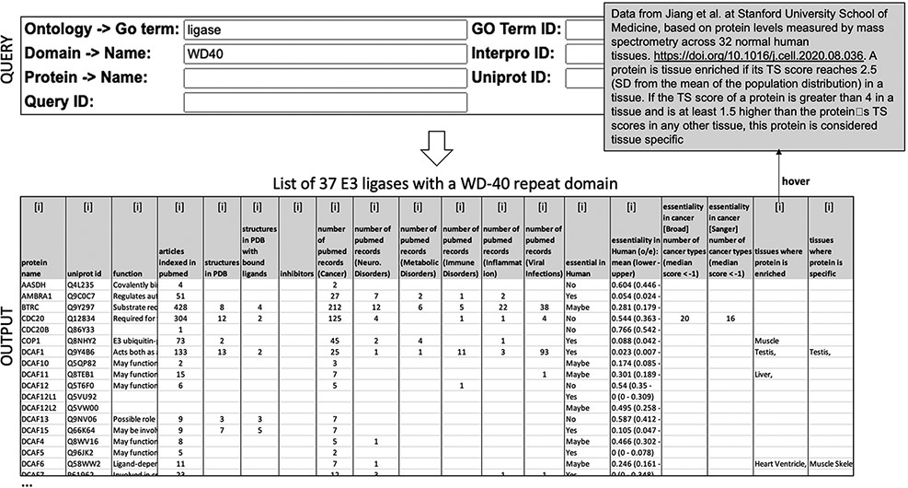
Figure 1. Querying ChemBioPort. A simple menu (top) is used to produce a downloadable list of proteins (bottom) with ...
Notes:
Figure 1. Querying ChemBioPort. A simple menu (top) is used to produce a downloadable list of proteins (bottom) with annotations extracted from a heterogenous array of data sources. Hovering over ‘information’ icons [i] provides details on the data source and interpretation (top-right).
Unless provided in the caption above, the following copyright applies to the content of this slide: © The Author(s) 2022. Published by Oxford University Press.This is an Open Access article distributed under the terms of the Creative Commons Attribution-NonCommercial License (https://creativecommons.org/licenses/by-nc/4.0/), which permits non-commercial re-use, distribution, and reproduction in any medium, provided the original work is properly cited. For commercial re-use, please contact journals.permissions@oup.com

Slide 2
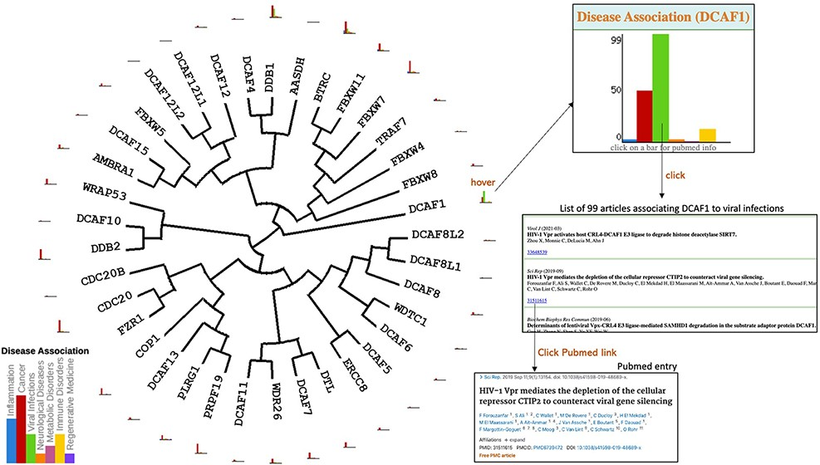
Figure 2. Disease association. Evolutionary dendograms for any table (Figure 1) are automatically generated, onto which ...
Notes:
Figure 2. Disease association. Evolutionary dendograms for any table (Figure 1) are automatically generated, onto which data can be projected. Here, histograms representing the number of articles indexed in PubMed linking each gene to specific disease areas are shown. Hovering over histogram icons opens larger bar charts where bars can be clicked to produce the list of articles, each linked to their respective PubMed entry.
Unless provided in the caption above, the following copyright applies to the content of this slide: © The Author(s) 2022. Published by Oxford University Press.This is an Open Access article distributed under the terms of the Creative Commons Attribution-NonCommercial License (https://creativecommons.org/licenses/by-nc/4.0/), which permits non-commercial re-use, distribution, and reproduction in any medium, provided the original work is properly cited. For commercial re-use, please contact journals.permissions@oup.com

Slide 3
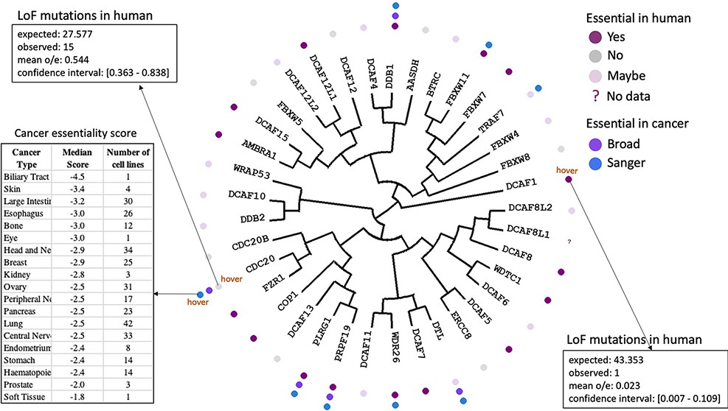
Figure 3. Essentiality in cancer and in healthy individuals. Cancer dependency data derived from CRISPR knockout ...
Notes:
Figure 3. Essentiality in cancer and in healthy individuals. Cancer dependency data derived from CRISPR knockout screens at the Broad and Wellcome Sanger Institutes (20, 21) is mapped next to each protein name in the dendogram. Hovering over icons provides details on essentiality score and number of cell lines representing each cancer type. The essentiality of each gene in healthy individuals derived from observed versus expected LoF mutations (12) is also projected on the tree.
Unless provided in the caption above, the following copyright applies to the content of this slide: © The Author(s) 2022. Published by Oxford University Press.This is an Open Access article distributed under the terms of the Creative Commons Attribution-NonCommercial License (https://creativecommons.org/licenses/by-nc/4.0/), which permits non-commercial re-use, distribution, and reproduction in any medium, provided the original work is properly cited. For commercial re-use, please contact journals.permissions@oup.com

Slide 4
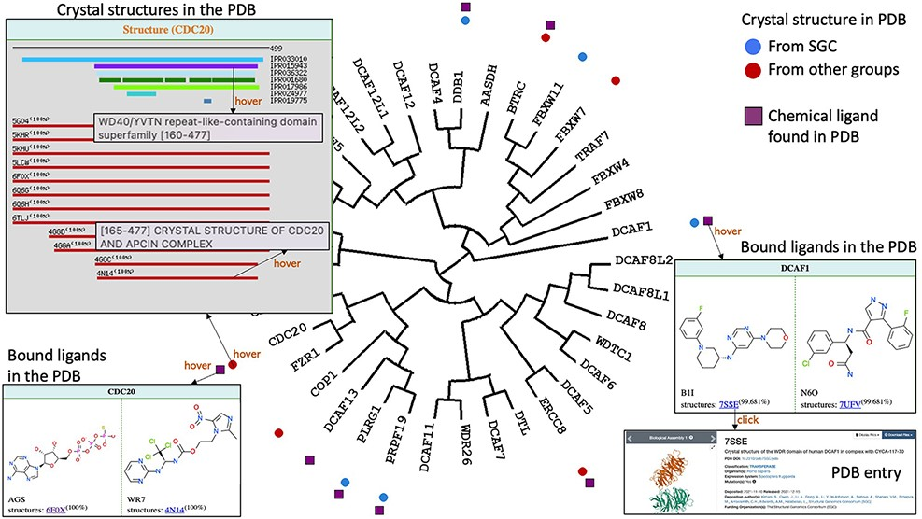
Figure 4. Structural and chemical coverage. Circular icons highlight which proteins have a crystal structure in the ...
Notes:
Figure 4. Structural and chemical coverage. Circular icons highlight which proteins have a crystal structure in the PDB. Hovering over an icon provides details on the domain architecture of the protein (including domain name and Interpro ID), the crystallized domains and their clickable PDB codes and titles linked to the associated PDB pages. Data on chemical ligands found in PDB structures were also mapped as square icons. Hovering brings image of the chemical structures and PDB codes.
Unless provided in the caption above, the following copyright applies to the content of this slide: © The Author(s) 2022. Published by Oxford University Press.This is an Open Access article distributed under the terms of the Creative Commons Attribution-NonCommercial License (https://creativecommons.org/licenses/by-nc/4.0/), which permits non-commercial re-use, distribution, and reproduction in any medium, provided the original work is properly cited. For commercial re-use, please contact journals.permissions@oup.com

