Slide 1
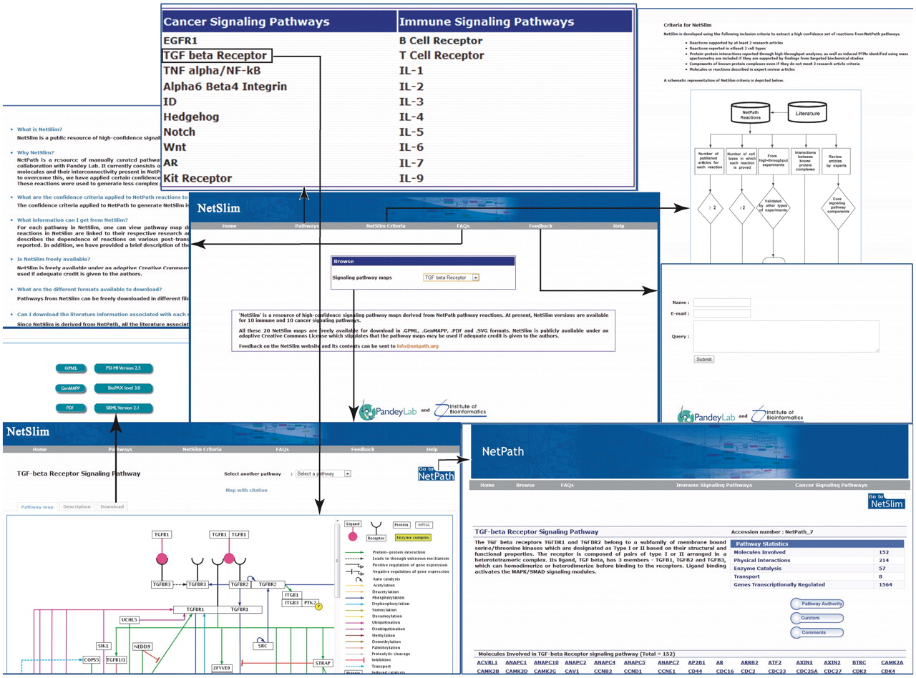
Figure 2. An overview of NetSlim. The NetSlim home page has options to browse the pathway maps. A description of the ...
Notes:
Figure 2. An overview of NetSlim. The NetSlim home page has options to browse the pathway maps. A description of the criteria used for NetSlim is available as a separate tab. Choosing a pathway such as the TGF beta signaling pathway, the ‘Pathway map’ tab provides access to the TGF-β NetSlim pathway map image and the ‘Description’ tab which has a brief description of the pathway. The ‘map with citation’ provided in the NetSlim pathway page contains molecules linked to specific NetPath molecule pages and their reactions linked to their corresponding citations. NetSlim maps can be downloaded in different file formats from specific pathway pages. The NetSlim data is also available to download in BioPAX, PSI-MI and SBML formats. A ‘Feedback’ page allows users to provide comments about the NetSlim resource. A link to NetSlim is provided on each pathway page in NetPath and vice versa.
Unless provided in the caption above, the following copyright applies to the content of this slide: © The Author(s) 2011. Published by Oxford University Press.This is Open Access article distributed under the terms of the Creative Commons Attribution Non-Commercial License (http://creativecommons.org/licenses/by-nc/2.5), which permits unrestricted non-commercial use, distribution, and reproduction in any medium, provided the original work is properly cited.

