Slide 1
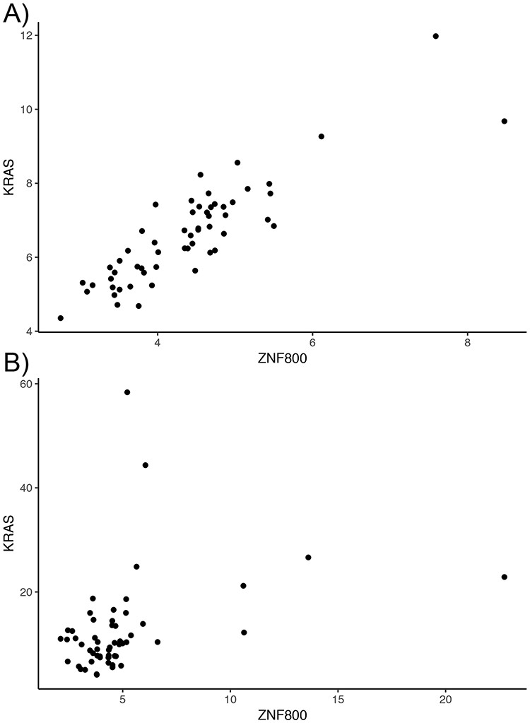
Figure 2. Lost co-expression in tumors. The dot plots illustrate the expression (measured as FPKM) of KRAS and ZNF800 ...
Notes:
Figure 2. Lost co-expression in tumors. The dot plots illustrate the expression (measured as FPKM) of KRAS and ZNF800 in (A) healthy lungs and (B) lung adenocarcinoma. Each dot reflects the expression of the two genes in one sample.
Unless provided in the caption above, the following copyright applies to the content of this slide: © The Author(s) 2020. Published by Oxford University Press.This is an Open Access article distributed under the terms of the Creative Commons Attribution License (http://creativecommons.org/licenses/by/4.0/), which permits unrestricted reuse, distribution, and reproduction in any medium, provided the original work is properly cited.

