Slide 1
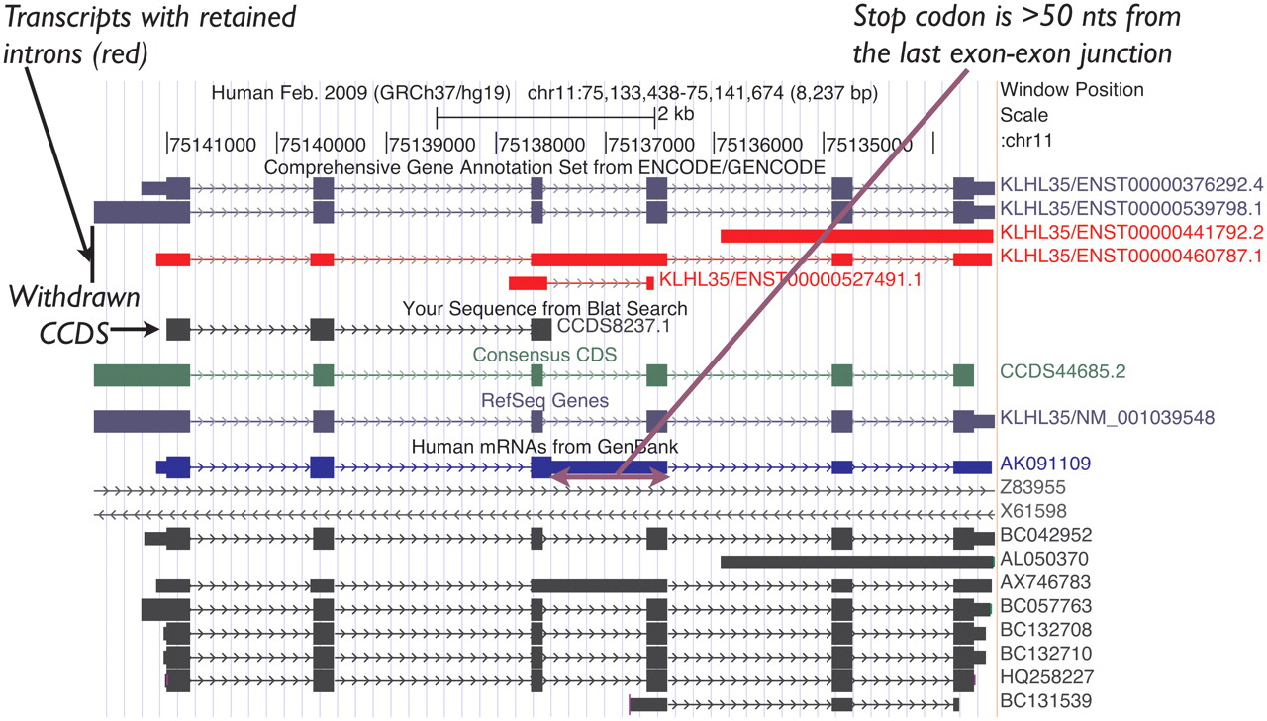
Figure 2. UCSC Genome Browser view of the human KLHL35 (kelch-like 35) gene. CCDS8237.1 was based on AK091109.1 (mRNA ...
Notes:
Figure 2. UCSC Genome Browser view of the human KLHL35 (kelch-like 35) gene. CCDS8237.1 was based on AK091109.1 (mRNA track, blue). This CCDS ID has now been withdrawn because a retained intron introduces a premature termination codon, rendering the transcript an NMD candidate. CCDS44685.2 representing the completely processed full-length variant remains valid for this gene.
Unless provided in the caption above, the following copyright applies to the content of this slide: Published by Oxford University Press on behalf of US Government 2012.This is an Open Access article distributed under the terms of the Creative Commons Attribution Non-Commercial License (http://creativecommons.org/licenses/by-nc/3.0), which permits unrestricted non-commercial use, distribution, and reproduction in any medium, provided the original work is properly cited.

