Slide 1
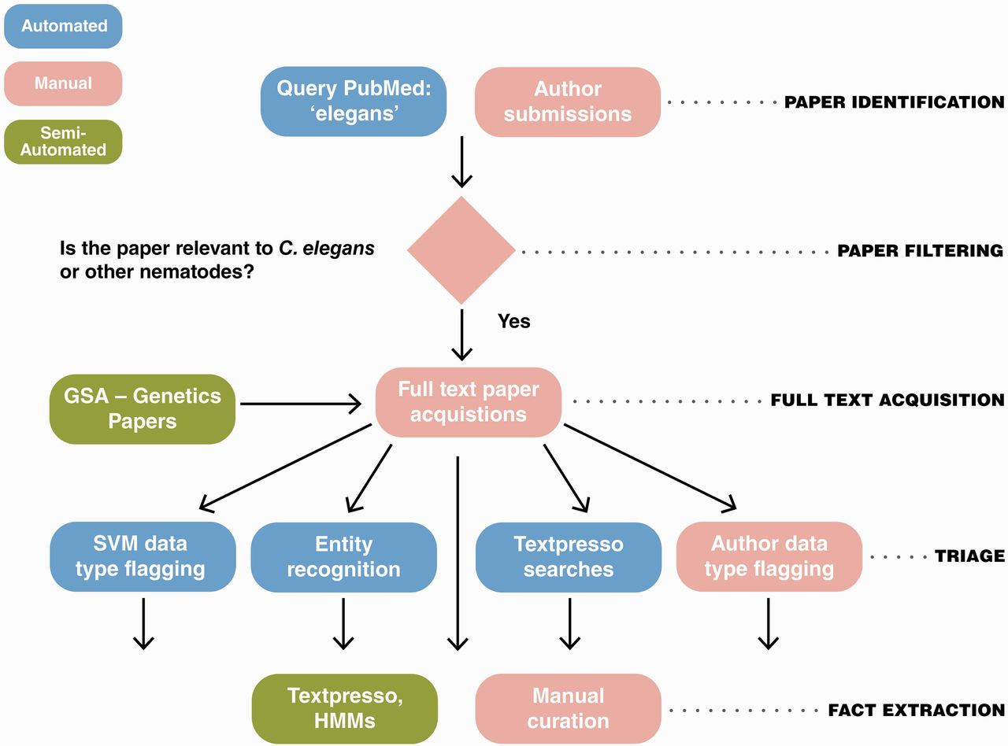
Figure 1 The WormBase literature curation workflow. WormBase literature curation incorporates automated (blue), ...
Notes:
Figure 1 The WormBase literature curation workflow. WormBase literature curation incorporates automated (blue), semi-automated (green) and manual (pink) steps. Potentially curatable papers are initially brought into WormBase primarily via PubMed searches with additional contributions from authors and a collaboration between WormBase and the GSA for Genetics and G3: Genes, Genomes, Genetics papers. Following full-text acquisition, a triage step is used to determine what data types are present in papers. The triage step is largely automated but also includes author contributions. Once papers have been flagged for data types, curators responsbile for curation of that data type use manual and semi-automated methods to extract the information and convert it into machine-readable format.
Unless provided in the caption above, the following copyright applies to the content of this slide: © The Author(s) 2012. Published by Oxford University Press.This is an Open Access article distributed under the terms of the Creative Commons Attribution License (http://creativecommons.org/licenses/by-nc/3.0/), which permits non-commercial reuse, distribution, and reproduction in any medium, provided the original work is properly cited. For commercial re-use, please contact journals.permissions@oup.com.

