Slide 1
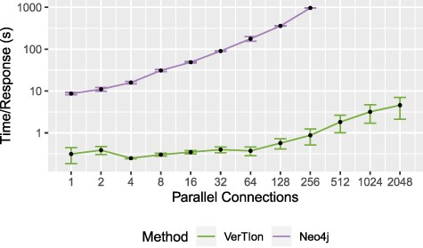
Fig. 7 Throughput for random walk-based network proximity queries. The average time until server response for a set ...
Notes:
Fig. 7 Throughput for random walk-based network proximity queries. The average time until server response for a set of parallel connections using a Neo4j database installation and VerTIoN. After 256 parallel requests, Neo4j becomes unstable and begins failing to respond to queries.
Unless provided in the caption above, the following copyright applies to the content of this slide: © The Author(s) 2020. Published by Oxford University Press.This is an Open Access article distributed under the terms of the Creative Commons Attribution License (http://creativecommons.org/licenses/by/4.0/), which permits unrestricted reuse, distribution, and reproduction in any medium, provided the original work is properly cited.

