Slide 1
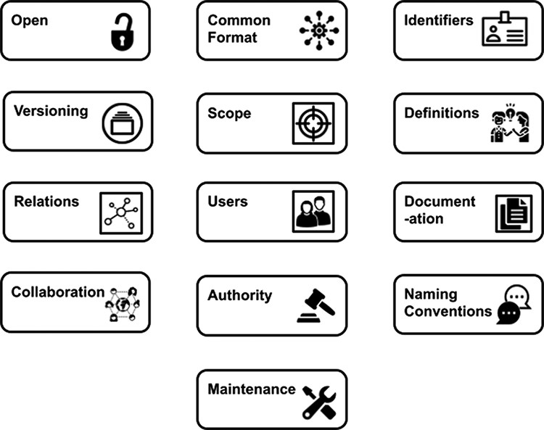
Figure 1. Illustration of the principles around which the OBO Foundry was built.
Notes:
Figure 1. Illustration of the principles around which the OBO Foundry was built.
Unless provided in the caption above, the following copyright applies to the content of this slide: © The Author(s) 2021. Published by Oxford University Press.This is an Open Access article distributed under the terms of the Creative Commons Attribution License (https://creativecommons.org/licenses/by/4.0/), which permits unrestricted reuse, distribution, and reproduction in any medium, provided the original work is properly cited.

Slide 2
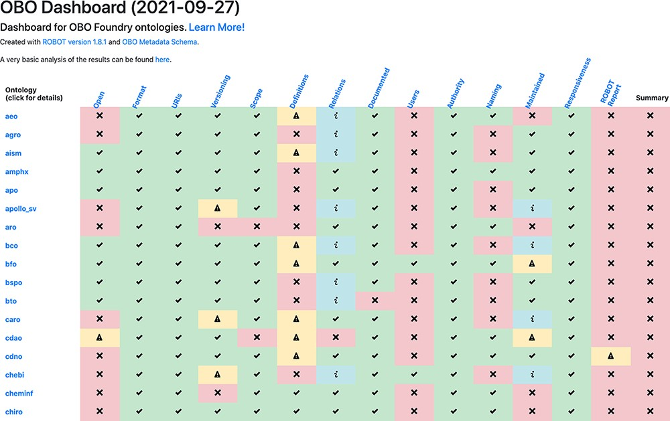
Figure 2. The OBO dashboard (truncated). The rows represent OBO ontologies (of which the first 15 in alphabetical order ...
Notes:
Figure 2. The OBO dashboard (truncated). The rows represent OBO ontologies (of which the first 15 in alphabetical order are shown here) and the columns are the OBO principles. The final column, ‘Summary’, shows whether the ontology passed all of the tests. Clicking on the ontology ID in the far left column directs to a detailed report page.
Unless provided in the caption above, the following copyright applies to the content of this slide: © The Author(s) 2021. Published by Oxford University Press.This is an Open Access article distributed under the terms of the Creative Commons Attribution License (https://creativecommons.org/licenses/by/4.0/), which permits unrestricted reuse, distribution, and reproduction in any medium, provided the original work is properly cited.

Slide 3
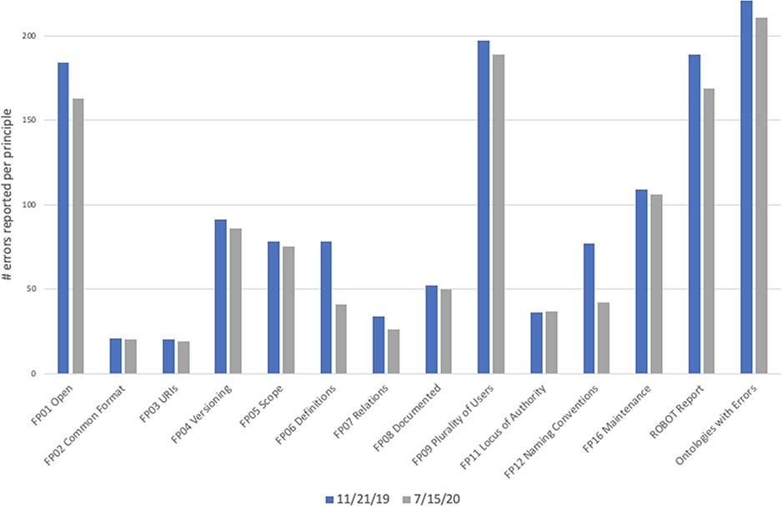
Figure 3. Number of errors reported by dashboard on 11 November 2019 (blue bars) and 15 July 2020 (gray bars). The ...
Notes:
Figure 3. Number of errors reported by dashboard on 11 November 2019 (blue bars) and 15 July 2020 (gray bars). The final column, ‘Ontologies with Errors’, is the total number of ontologies that had one or more errors, not a count of all errors. While more ontologies joined the OBO Foundry between these two dates, we only included statistics for the 223 ontologies that were present and active in both the first run and the second run. The automated checks remained the same during this time period.
Unless provided in the caption above, the following copyright applies to the content of this slide: © The Author(s) 2021. Published by Oxford University Press.This is an Open Access article distributed under the terms of the Creative Commons Attribution License (https://creativecommons.org/licenses/by/4.0/), which permits unrestricted reuse, distribution, and reproduction in any medium, provided the original work is properly cited.

Slide 4
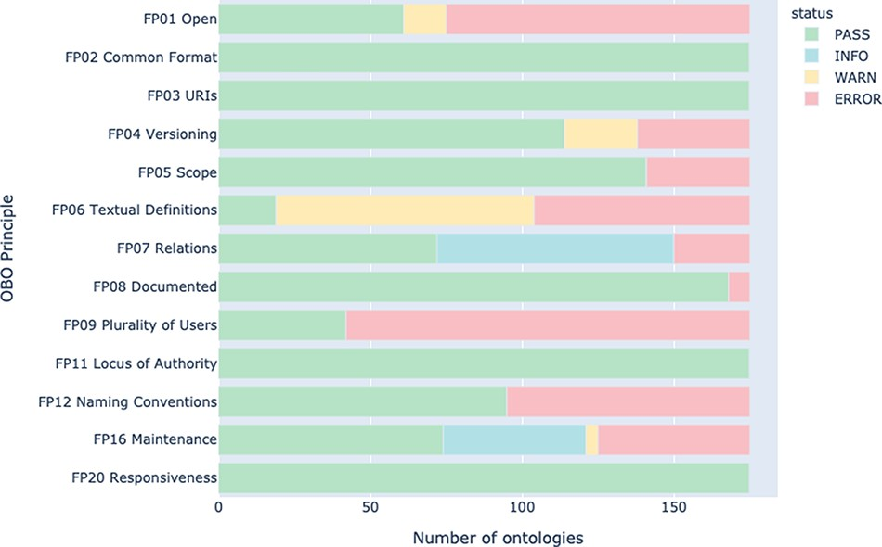
Figure 4. Summary of principle conformance across all active OBO Foundry ontologies in May 2021.
Notes:
Figure 4. Summary of principle conformance across all active OBO Foundry ontologies in May 2021.
Unless provided in the caption above, the following copyright applies to the content of this slide: © The Author(s) 2021. Published by Oxford University Press.This is an Open Access article distributed under the terms of the Creative Commons Attribution License (https://creativecommons.org/licenses/by/4.0/), which permits unrestricted reuse, distribution, and reproduction in any medium, provided the original work is properly cited.

