Slide 1
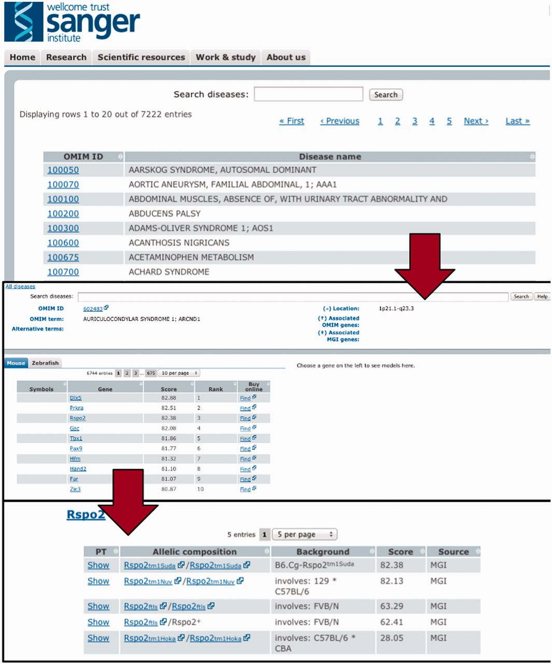
Figure 3. To efficiently browse the obtained prioritisation results, a web interface was developed. As illustrated ...
Notes:
Figure 3. To efficiently browse the obtained prioritisation results, a web interface was developed. As illustrated here, the interface allows the user to browse by and search for diseases and obtain all prioritized models sorted according to species and genes. Genes can then be expanded to models and even to the level of phenotype descriptions to show on what basis the match occured.
Unless provided in the caption above, the following copyright applies to the content of this slide: © The Author(s) 2013. Published by Oxford University Press.This is an Open Access article distributed under the terms of the Creative Commons Attribution Non-Commercial License (http://creativecommons.org/licenses/by-nc/3.0/), which permits non-commercial re-use, distribution, and reproduction in any medium, provided the original work is properly cited. For commercial re-use, please contact journals.permissions@oup.com

