Slide 1
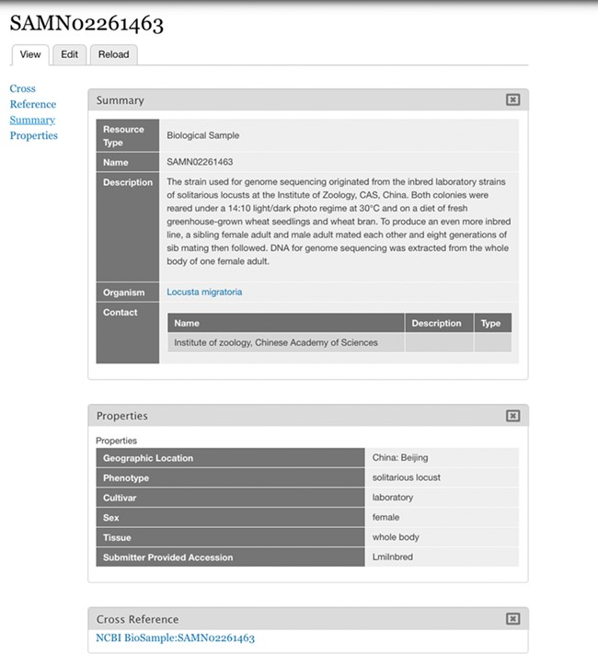
Figure 3 Imported BioSample. BioSample SAMN02261463 represented as a Chado Biomaterial/Tripal Sample bundle as ...
Notes:
Figure 3 Imported BioSample. BioSample SAMN02261463 represented as a Chado Biomaterial/Tripal Sample bundle as imported by the Tripal EUtils module. The properties imported are for geographic location, phenotype, cultivar, sex, tissue and submitter provided accession.
Unless provided in the caption above, the following copyright applies to the content of this slide: Published by Oxford University Press 2020.This work is written by US Government employees and is in the public domain in the US.

