Slide 1
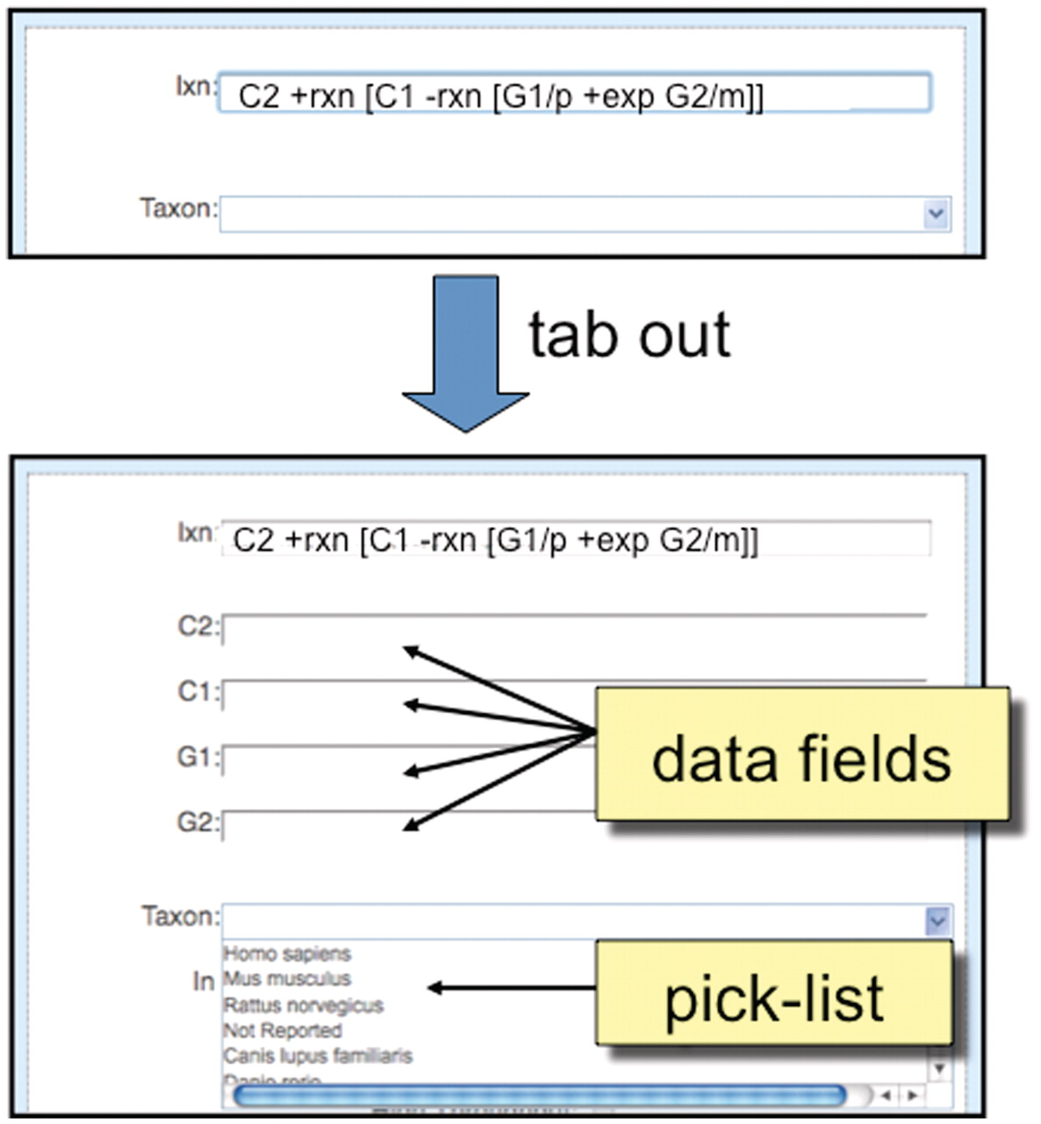
Figure 5. Detailed view of ‘Interaction Entry Page’. After a biocurator composes a new interaction and tabs out of the ...
Notes:
Figure 5. Detailed view of ‘Interaction Entry Page’. After a biocurator composes a new interaction and tabs out of the cell, the curation tool automatically pops up the required data fields (here, C2, C1, G1 and G2) to correctly complete the interaction. Since ‘Taxon’ is a requirement of all interactions, it is always displayed in the curation tool window, and biocurators can either use a pick-list to select the most commonly entered species or directly type in any species.
Unless provided in the caption above, the following copyright applies to the content of this slide: © The Author(s) 2011. Published by Oxford University Press.This is Open Access article distributed under the terms of the Creative Commons Attribution Non-Commercial License (http://creativecommons.org/licenses/by-nc/2.5), which permits unrestricted non-commercial use, distribution, and reproduction in any medium, provided the original work is properly cited.

