Slide 1
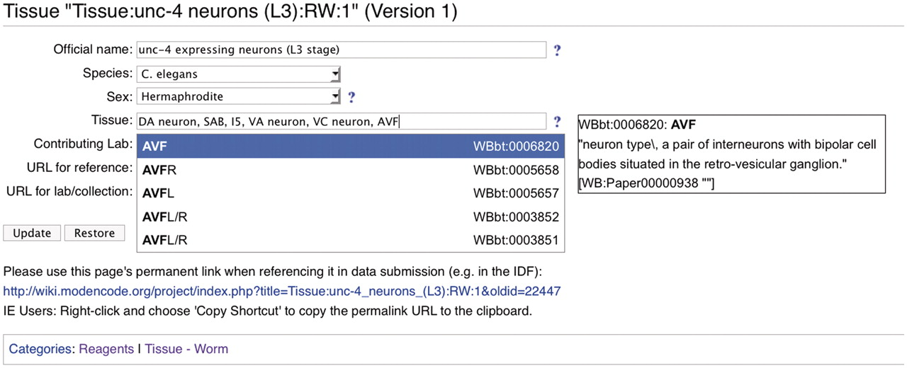
Figure 3. Screenshot of a modENCODE wiki tissue page using DBFields template. In this example, WormBase cell and ...
Notes:
Figure 3. Screenshot of a modENCODE wiki tissue page using DBFields template. In this example, WormBase cell and anatomy ontology (24) terms are selected to describe unc-4 expressing neurons in the L3 stage. The DBFields template for tissues was configured to include fields for a colloquial name, species, sex, tissue, contributing lab and related external URLs. The tissue field allows for multiple selections from the configured ontology; as the user starts to type a phrase (such as AVF), partial matches are displayed for selection and the corresponding definition is displayed on the right. After the user ‘Updates’ the form to accept the changes, an updated URL is displayed for the user to refer specifically to this version of the wiki page. This URL is used in the BIR-TAB metadata documents to describe the sample, and the vetting software retrieves the field values during processing.
Unless provided in the caption above, the following copyright applies to the content of this slide: © The Author(s) 2011. Published by Oxford University Press.This is Open Access article distributed under the terms of the Creative Commons Attribution Non-Commercial License (http://creativecommons.org/licenses/by-nc/2.5), which permits unrestricted non-commercial use, distribution, and reproduction in any medium, provided the original work is properly cited.

