Slide 1
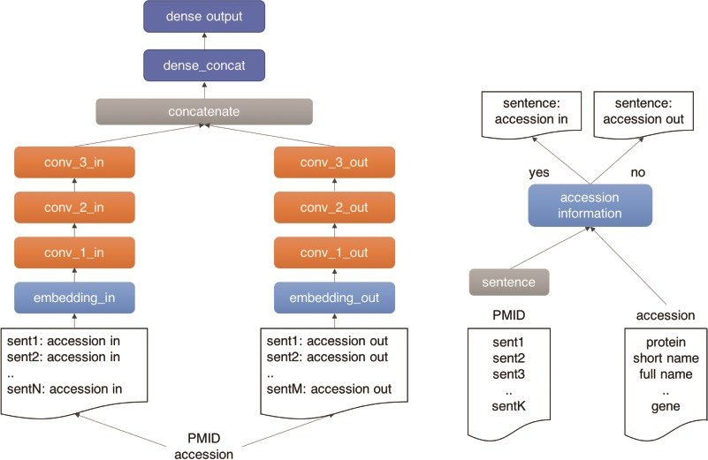
Figure 4 Outline of the UPCLASS CNN-based classification architecture with an embedding layer, three CNN layers ...
Notes:
Figure 4 Outline of the UPCLASS CNN-based classification architecture with an embedding layer, three CNN layers followed by two dense layers. The ‘positive’ sentences (accession in) are concatenated and fed to one branch of the model (‘in’ branch). The leftover sentences (accession out) are used to create the ‘negative’ document and fed to the other branch of the model (‘out’ branch).
Unless provided in the caption above, the following copyright applies to the content of this slide: © The Author(s) 2020. Published by Oxford University Press.This is an Open Access article distributed under the terms of the Creative Commons Attribution License (http://creativecommons.org/licenses/by/4.0/), which permits unrestricted reuse, distribution, and reproduction in any medium, provided the original work is properly cited.

