Slide 1
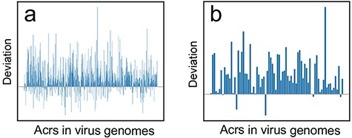
Figure 4. The deviation (${\bf{\it{CU}}}{{\bf{\it{B}}}_{{\bf{\it{acr}}}\_{\bf{\it{CDS}}}}} - ...
Notes:
Figure 4. The deviation (${\bf{\it{CU}}}{{\bf{\it{B}}}_{{\bf{\it{acr}}}\_{\bf{\it{CDS}}}}} - {\bf{\it{CU}}}{{\bf{\it{B}}}_{{\bf{\it{acr}}}\_{\bf{\it{interORFs}}}}}$) distribution at two different BLASTp cutoffs. (a) Deviation distribution calculated by comparison between CDS vs. acrs ($CU{B_{acr\_CDS}}$) and intergenic ORFs vs. acrs ($CU{B_{acr\_interORFs}}$) at a threshold of e-value ≤10e−3; (b) Deviation distribution calculated by comparison between $CU{B_{acr\_CDS}}$ and $CU{B_{acr\_interORFs}}$ at a threshold of e-value ≤10e−6.
Unless provided in the caption above, the following copyright applies to the content of this slide: © The Author(s) 2022. Published by Oxford University Press.This is an Open Access article distributed under the terms of the Creative Commons Attribution License (https://creativecommons.org/licenses/by/4.0/), which permits unrestricted reuse, distribution, and reproduction in any medium, provided the original work is properly cited.

