Slide 1
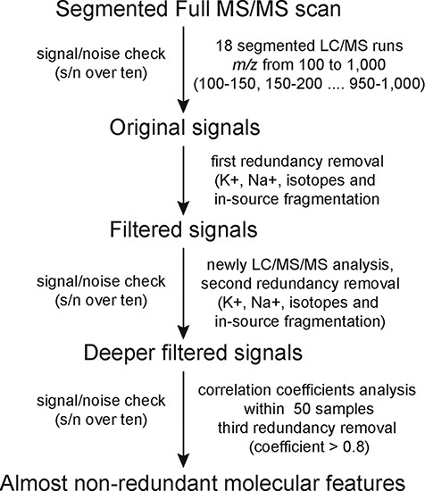
Figure 1 The workflow of MS2T library construction based on HPLC-MS/MS and its practical application in mulberry.
Notes:
Figure 1 The workflow of MS2T library construction based on HPLC-MS/MS and its practical application in mulberry.
Unless provided in the caption above, the following copyright applies to the content of this slide: © The Author(s) 2020. Published by Oxford University Press.This is an Open Access article distributed under the terms of the Creative Commons Attribution License (http://creativecommons.org/licenses/by/4.0/), which permits unrestricted reuse, distribution, and reproduction in any medium, provided the original work is properly cited.

Slide 2
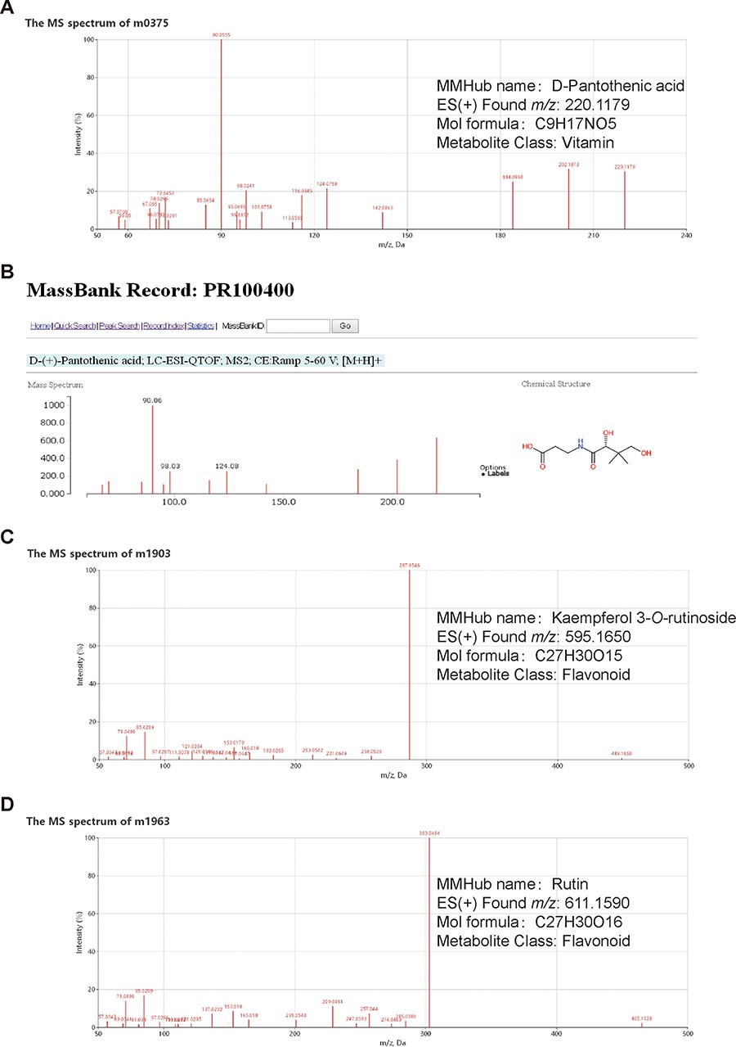
Figure 2 Examples of metabolite identification based on database comparisons and specific fragmentation patterns in ...
Notes:
Figure 2 Examples of metabolite identification based on database comparisons and specific fragmentation patterns in MMHub. Molecular feature m0375 (A) was identified as D-pantothenic acid by comparison with MassBank (B). Two molecular features (m1903 and m1963) were annotated as kaempferol 3-O-rutinoside (C) and rutin (D) based on flavonoid-specific fragmentation patterns. Identities of three metabolites shown in this figure were confirmed by comparison with authentic standards.
Unless provided in the caption above, the following copyright applies to the content of this slide: © The Author(s) 2020. Published by Oxford University Press.This is an Open Access article distributed under the terms of the Creative Commons Attribution License (http://creativecommons.org/licenses/by/4.0/), which permits unrestricted reuse, distribution, and reproduction in any medium, provided the original work is properly cited.

Slide 3
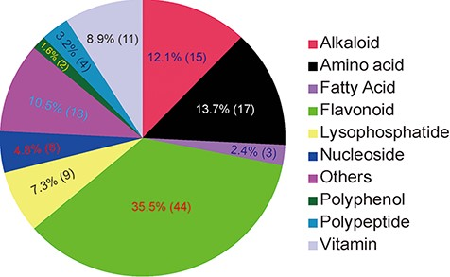
Figure 3 Classification of 124 identified/annotated metabolites in MMHub. The numbers of metabolites in each ...
Notes:
Figure 3 Classification of 124 identified/annotated metabolites in MMHub. The numbers of metabolites in each classification are shown in parentheses.
Unless provided in the caption above, the following copyright applies to the content of this slide: © The Author(s) 2020. Published by Oxford University Press.This is an Open Access article distributed under the terms of the Creative Commons Attribution License (http://creativecommons.org/licenses/by/4.0/), which permits unrestricted reuse, distribution, and reproduction in any medium, provided the original work is properly cited.

Slide 4
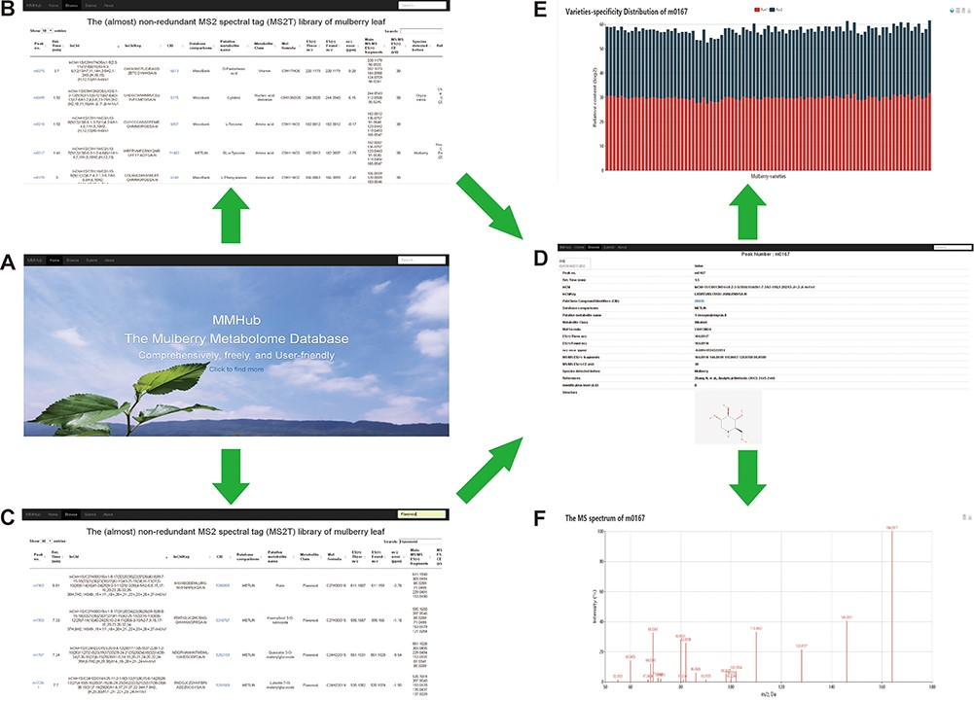
Figure 4 Snapshots of searches for metabolites and related information in MMHub. Researchers can retrieve general ...
Notes:
Figure 4 Snapshots of searches for metabolites and related information in MMHub. Researchers can retrieve general information about metabolites by basic browsing (A and B) or specific searches (C). Detailed information including available compound information (D), quantitative data (E) and mass spectrum (F) retrieved by clicking the ‘Peak no.’ link.
Unless provided in the caption above, the following copyright applies to the content of this slide: © The Author(s) 2020. Published by Oxford University Press.This is an Open Access article distributed under the terms of the Creative Commons Attribution License (http://creativecommons.org/licenses/by/4.0/), which permits unrestricted reuse, distribution, and reproduction in any medium, provided the original work is properly cited.

Slide 5
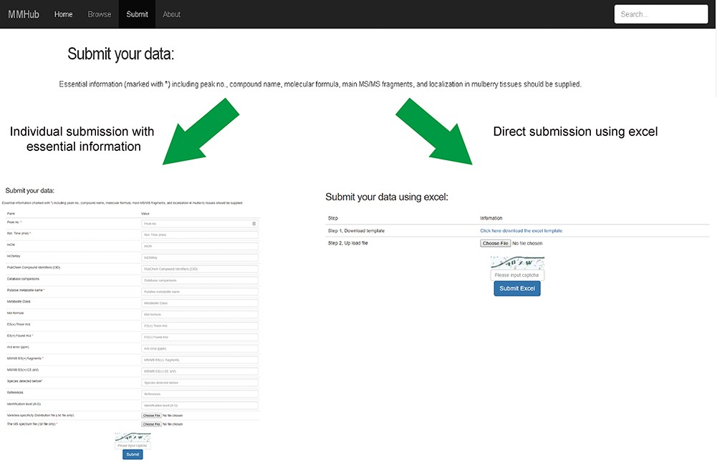
Figure 5 User guide for uploading and submission of mass spectra data into MMHub.
Notes:
Figure 5 User guide for uploading and submission of mass spectra data into MMHub.
Unless provided in the caption above, the following copyright applies to the content of this slide: © The Author(s) 2020. Published by Oxford University Press.This is an Open Access article distributed under the terms of the Creative Commons Attribution License (http://creativecommons.org/licenses/by/4.0/), which permits unrestricted reuse, distribution, and reproduction in any medium, provided the original work is properly cited.

