Slide 1
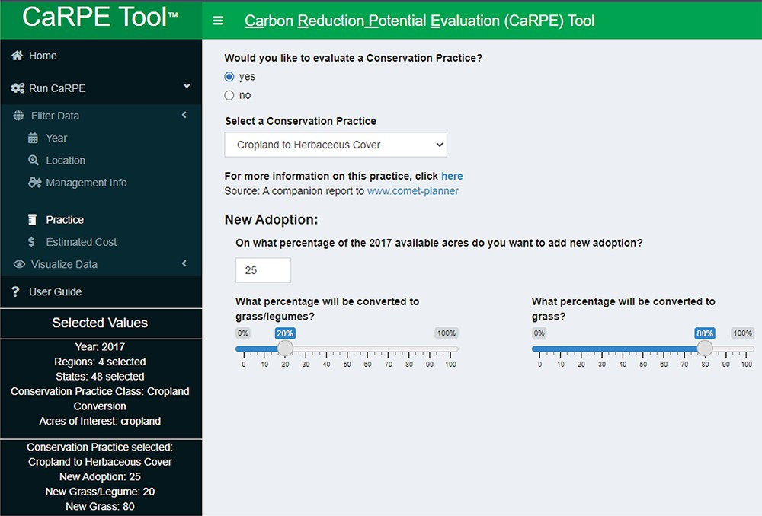
Figure 6. Example of the cropland to herbaceous cover practice illustrating user-defined variables for percent new ...
Notes:
Figure 6. Example of the cropland to herbaceous cover practice illustrating user-defined variables for percent new adoption and what percent will be converted to grass/legume or grass. Because conversion options remove cropland or grazing land from production, it is recommended to not exceed 25% new adoption without adequate justification.
Unless provided in the caption above, the following copyright applies to the content of this slide: Published by Oxford University Press 2022. This work is written by (a) US Government employee(s) and is in the public domain in the US.This work is written by (a) US Government employee(s) and is in the public domain in the US.

