Slide 1
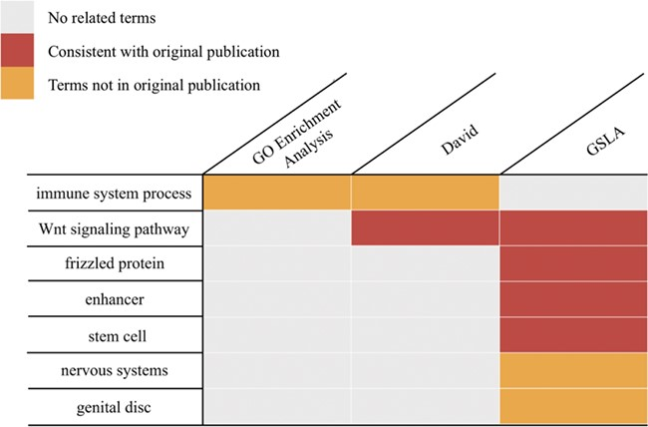
Figure 5 Functional interpretations produced by PDIR/GSLA. Compared with GO enrichment analysis and DAVID, the ...
Notes:
Figure 5 Functional interpretations produced by PDIR/GSLA. Compared with GO enrichment analysis and DAVID, the annotations produced by GSLA are more comprehensive and more accurate.
Unless provided in the caption above, the following copyright applies to the content of this slide: © The Author(s) 2020. Published by Oxford University Press.This article is published and distributed under the terms of the Oxford University Press, Standard Journals Publication Model (https://academic.oup.com/journals/pages/open_access/funder_policies/chorus/standard_publication_model)

