Slide 1
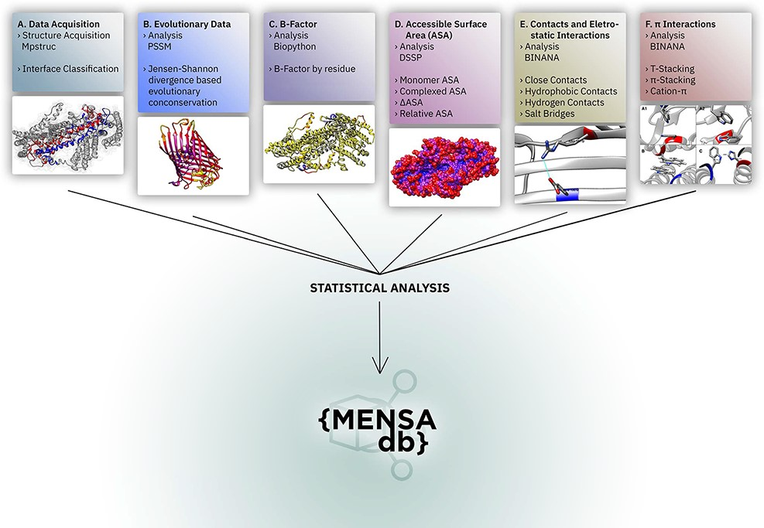
Figure 1. Overall representation of MENSAdb. Boxes A–F illustrate the steps involving the data collection, evolutionary ...
Notes:
Figure 1. Overall representation of MENSAdb. Boxes A–F illustrate the steps involving the data collection, evolutionary conservation, B-factor, accessible surface and PPI analysis. Each box contains an example of the proteinic motifs under the scope of this work. (A) Interface between chains A and B of the STRA6 receptor for retinol uptake in Danio rerio (PDBid: 5SY1) (55). (B) Representation of evolutionary conservation of protein motifs (purple being more conserved and yellow less conserved) in the chain P of a hedgehog auto-processing domain in Drosophila melanogaster (PDBid: 1AT0) (56). (C) and (D) Average B-factor and complexed accessible surface area, respectively, of the chains A and B of 5SY1 (55). (E) Salt bridge between GLU120 and ARG161 of the chain Q of the sucrose-specific porin (PDBid: 1A0T) of Salmonella typhimurium (57). (F) The spectrum of π systems predicted: (A1 and A2) T-stacking motif between TRP25 (chain L) and TRP255 (chain M) from Rattus norvegicus S100B protein (PDBid: 1XYD) (58) is represented from two perspectives; (B) illustration of a π–π stacking structure between TRP262 (chain A) and TRP262 (chain B) from Archaeoglobus fulgidus CDP-alcohol phosphotransferase (PDBid: 4O6M) (59) and (C) cation–π interaction between HIS275 (chain B) and TRP175 (chain C) from Escherichia coli formate dehydrogenase-N (PDNid: 1KQF) (60).
Unless provided in the caption above, the following copyright applies to the content of this slide: © The Author(s) 2021. Published by Oxford University Press.This is an Open Access article distributed under the terms of the Creative Commons Attribution License (http://creativecommons.org/licenses/by/4.0/), which permits unrestricted reuse, distribution, and reproduction in any medium, provided the original work is properly cited.

Slide 2
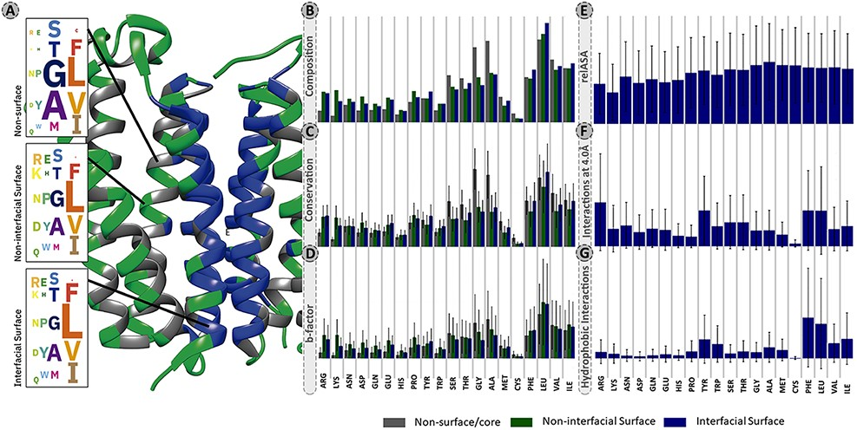
Figure 2. Panel of selected structural and physicochemical properties of MPs and their interactions. (A)—residue ...
Notes:
Figure 2. Panel of selected structural and physicochemical properties of MPs and their interactions. (A)—residue distribution of the translocator membrane protein (PDBid: 4UC1) from Rhodobacter sphaeroides (61). Amino acids are coloured according to the protein region within which they are embedded: grey—non-surface residues; green—non-interfacial surface residues; blue—interfacial surface residues. (B)—residue composition of the database. The correction factor described in section “Data treatment” of Material and methods was not applied here. (C)—normalized evolutionary conservation scores. (D)—normalized B-factor scores. (E)—normalized relASA. (F)—normalized intermolecular contacts at 4 Å. (G)—normalized hydrophobic contacts.
Unless provided in the caption above, the following copyright applies to the content of this slide: © The Author(s) 2021. Published by Oxford University Press.This is an Open Access article distributed under the terms of the Creative Commons Attribution License (http://creativecommons.org/licenses/by/4.0/), which permits unrestricted reuse, distribution, and reproduction in any medium, provided the original work is properly cited.

Slide 3
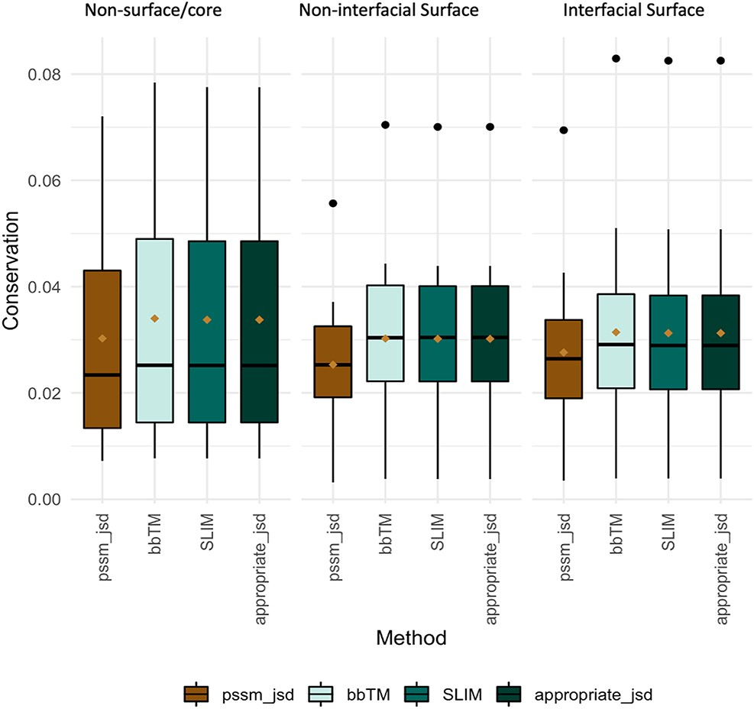
Figure 3. Conservation JSD distribution using BLOSUM62, SLIM, bbTM and the appropriate JSD background matrices (SLIM ...
Notes:
Figure 3. Conservation JSD distribution using BLOSUM62, SLIM, bbTM and the appropriate JSD background matrices (SLIM and bbTM were considered for α-helix and β-barrel proteins, respectively). Mean values are represented as a brown diamond. The results from the multiple pairwise test against all three background matrices yielded non-significant.
Unless provided in the caption above, the following copyright applies to the content of this slide: © The Author(s) 2021. Published by Oxford University Press.This is an Open Access article distributed under the terms of the Creative Commons Attribution License (http://creativecommons.org/licenses/by/4.0/), which permits unrestricted reuse, distribution, and reproduction in any medium, provided the original work is properly cited.

Slide 4
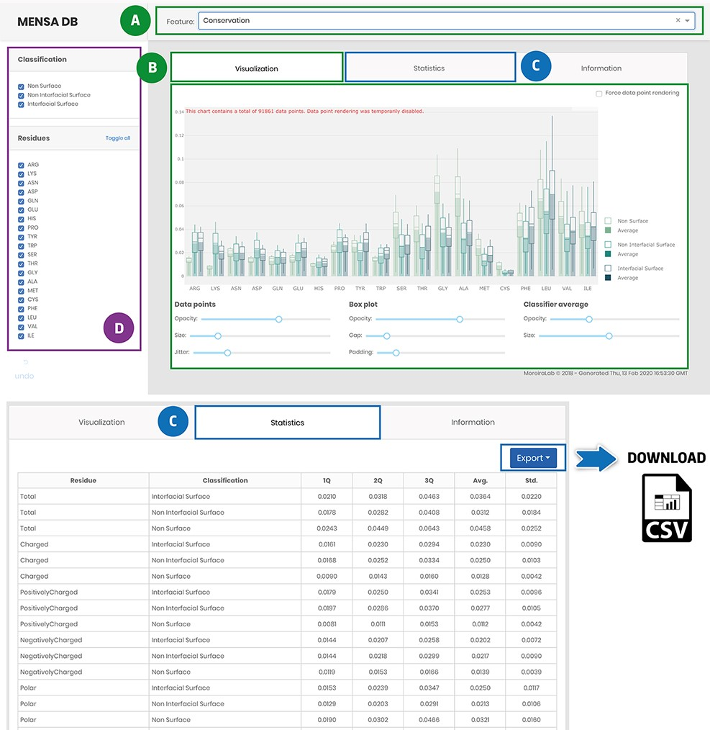
Figure 4. Main landing page of MENSAdb web server. Screenshot of the home page (A)—quickly query by evolutionary or ...
Notes:
Figure 4. Main landing page of MENSAdb web server. Screenshot of the home page (A)—quickly query by evolutionary or physicochemical features. (B)—In the visualization tab, the results are shown in a graphical format. Users can easily change visual properties (opacity, size, jitter, gap and padding) by interacting with the lower panel. (C)—Statistics tab displays the data in a tabular format with associated metrics (Q1, Q2, Q3, Average-Avg. and Standard Deviation-Std.). Stats and raw data can be downloaded using the Export button in the top right corner, as a .csv file. (D)—In the left panel, users can filter graphic data by classification and residue type.
Unless provided in the caption above, the following copyright applies to the content of this slide: © The Author(s) 2021. Published by Oxford University Press.This is an Open Access article distributed under the terms of the Creative Commons Attribution License (http://creativecommons.org/licenses/by/4.0/), which permits unrestricted reuse, distribution, and reproduction in any medium, provided the original work is properly cited.

