Slide 1
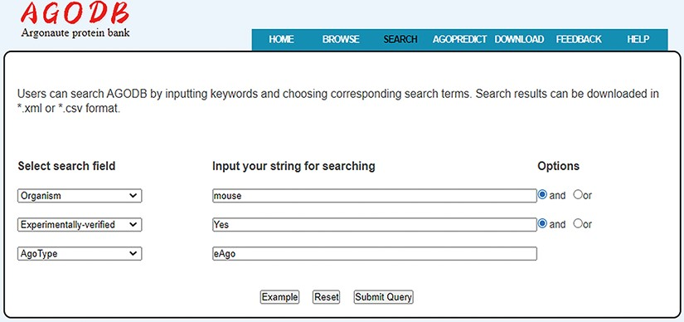
Figure 5. Search interface of AGODB. For example, if users want to retrieve all the experimentally validated eAgo ...
Notes:
Figure 5. Search interface of AGODB. For example, if users want to retrieve all the experimentally validated eAgo proteins from mouse, they should first select the search field ‘Organism’ from the pull-down list box, input ‘mouse’ into the corresponding blank text form and select the ‘and’ button. Then, users should select the ‘Experimentally-verified’ search field, input ‘Yes’ and select the ‘and’ button. Finally, they should select the ‘AgoType’ field, input ‘eAgo’ and press the ‘Submit Query’ button.
Unless provided in the caption above, the following copyright applies to the content of this slide: © The Author(s) 2022. Published by Oxford University Press.This is an Open Access article distributed under the terms of the Creative Commons Attribution-NonCommercial License (https://creativecommons.org/licenses/by-nc/4.0/), which permits non-commercial re-use, distribution, and reproduction in any medium, provided the original work is properly cited. For commercial re-use, please contact journals.permissions@oup.com

