Slide 1
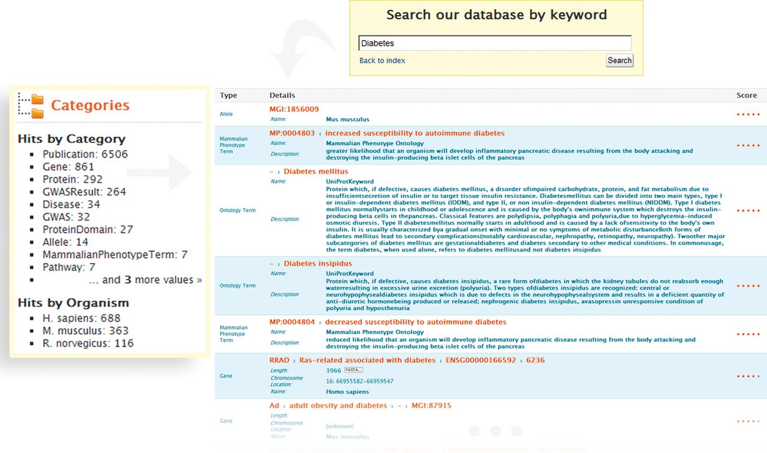
Figure 1. Keyword search and faceted results filtering in metabolicMine. A researcher conducts a broad keyword search ...
Notes:
Figure 1. Keyword search and faceted results filtering in metabolicMine. A researcher conducts a broad keyword search with the word ‘Diabetes’. The search engine operates across all data fields, and a category filter shows the different data types matching the search terms (e.g. Gene, Protein, GO Term or GWAS). The Lucene indexing library generates a score from 0 to 1 for the keyword search, based on how closely the search term matched what is in the search index. The results can then be refined by Category (by selecting, for example, ‘Gene’ or Publication) or by Organism (human, rat or mouse).
Unless provided in the caption above, the following copyright applies to the content of this slide: © Crown copyright 2013.

