Slide 1
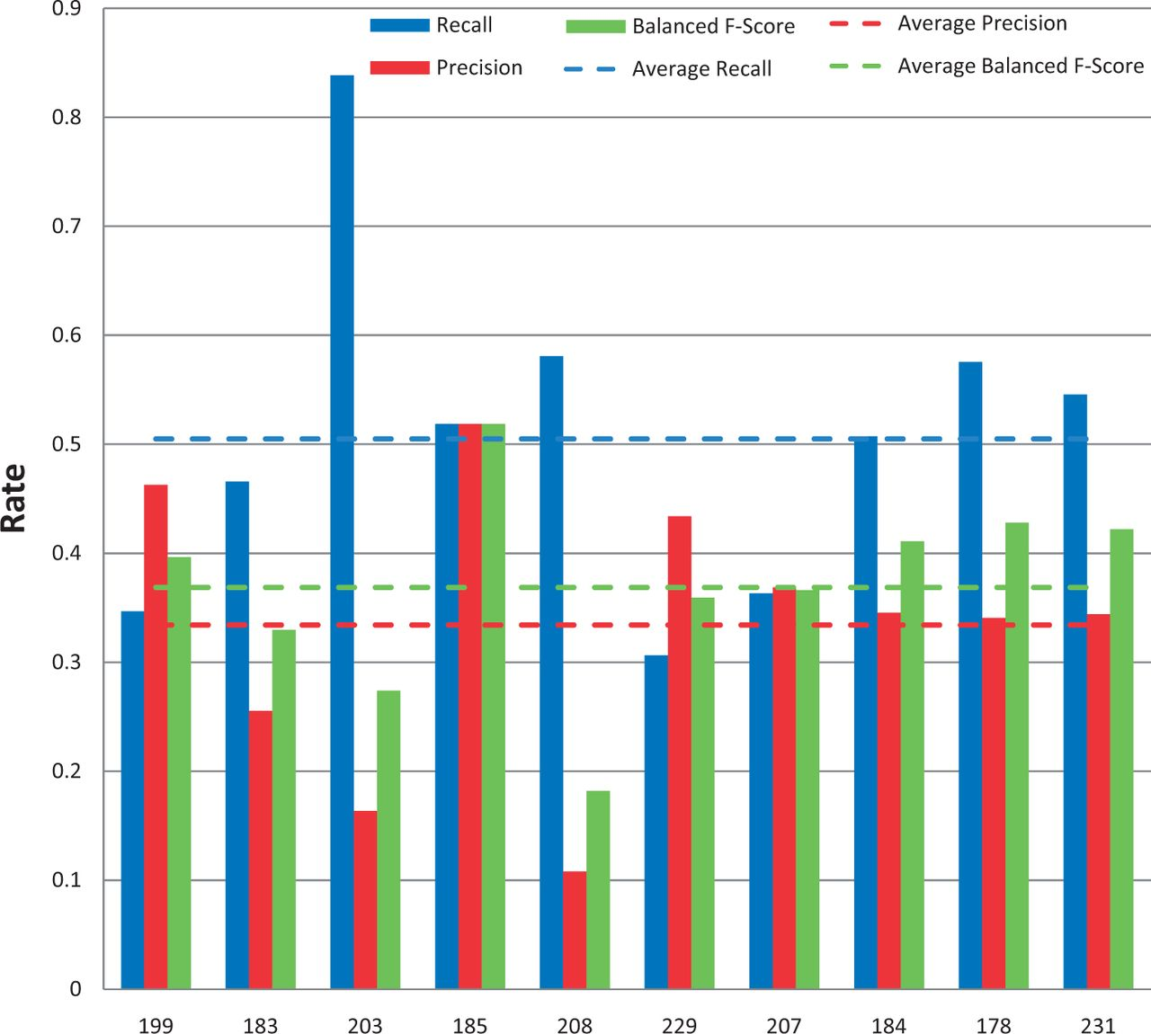
Figure 9. Action term named-entity recognition. Chemical/gene action term recall (blue), precision (red) and balanced ...
Notes:
Figure 9. Action term named-entity recognition. Chemical/gene action term recall (blue), precision (red) and balanced F-score (green) results are shown for each participating group (anonymously identified by group number on x-axis). Average scores for each metric (dotted lines) are also provided.
Unless provided in the caption above, the following copyright applies to the content of this slide: © The Author(s) 2014. Published by Oxford University Press.This is an Open Access article distributed under the terms of the Creative Commons Attribution License (http://creativecommons.org/licenses/by/3.0/), which permits unrestricted reuse, distribution, and reproduction in any medium, provided the original work is properly cited.

