Slide 1
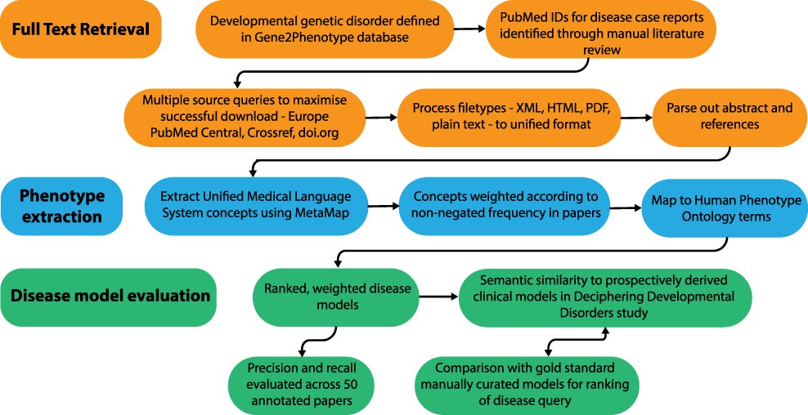
Figure 1. Overview of the disease model pipeline. Input was PMIDs for case reports describing developmental genetic ...
Notes:
Figure 1. Overview of the disease model pipeline. Input was PMIDs for case reports describing developmental genetic disorders. Full-text downloads were performed using the Cadmus package. Output was disease models consisting of HPO terms weighted according to their frequency in full text. These were evaluated against ‘real life’ models from the Deciphering Developmental Disorders study and against gold standard manually curated models.
Unless provided in the caption above, the following copyright applies to the content of this slide: © The Author(s) 2022. Published by Oxford University Press.This is an Open Access article distributed under the terms of the Creative Commons Attribution-NonCommercial License (https://creativecommons.org/licenses/by-nc/4.0/), which permits non-commercial re-use, distribution, and reproduction in any medium, provided the original work is properly cited. For commercial re-use, please contact journals.permissions@oup.com

