Slide 1
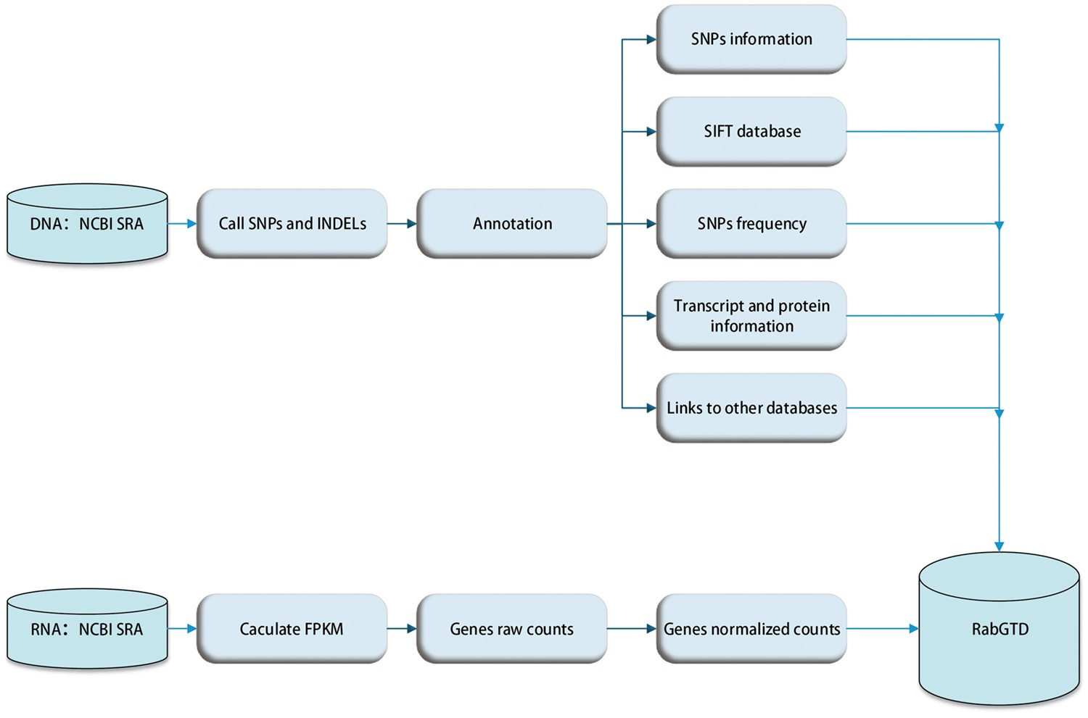
Figure 1. The flow diagram of data preprocessing.
Notes:
Figure 1. The flow diagram of data preprocessing.
Unless provided in the caption above, the following copyright applies to the content of this slide: © The Author(s) 2018. Published by Oxford University Press.This is an Open Access article distributed under the terms of the Creative Commons Attribution License (http://creativecommons.org/licenses/by/4.0/), which permits unrestricted reuse, distribution, and reproduction in any medium, provided the original work is properly cited.

Slide 2
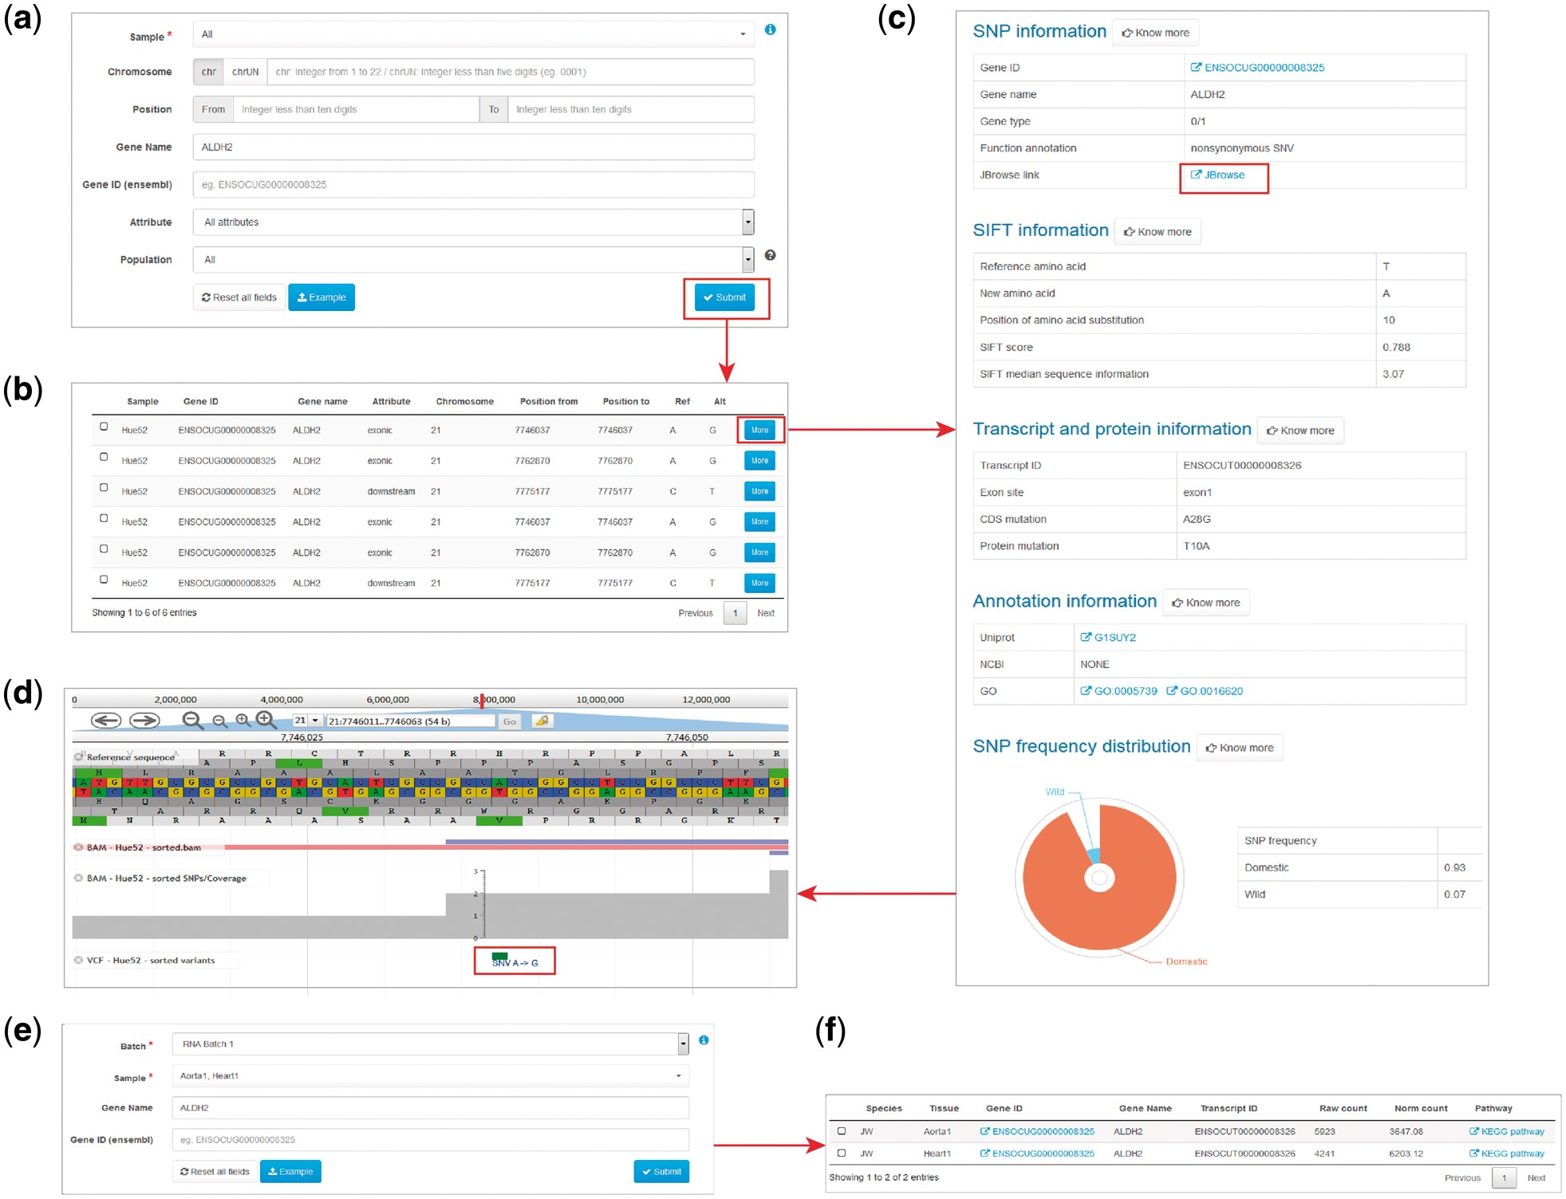
Figure 2. Examples of variant and expression search. (a) Entry of variant search. (b) Results of variant search. (c) ...
Notes:
Figure 2. Examples of variant and expression search. (a) Entry of variant search. (b) Results of variant search. (c) Extended results of variant search. (d) Display of the variant with JBrowse. (e) Entry of expression search. (f) Result of expression search.
Unless provided in the caption above, the following copyright applies to the content of this slide: © The Author(s) 2018. Published by Oxford University Press.This is an Open Access article distributed under the terms of the Creative Commons Attribution License (http://creativecommons.org/licenses/by/4.0/), which permits unrestricted reuse, distribution, and reproduction in any medium, provided the original work is properly cited.

Slide 3
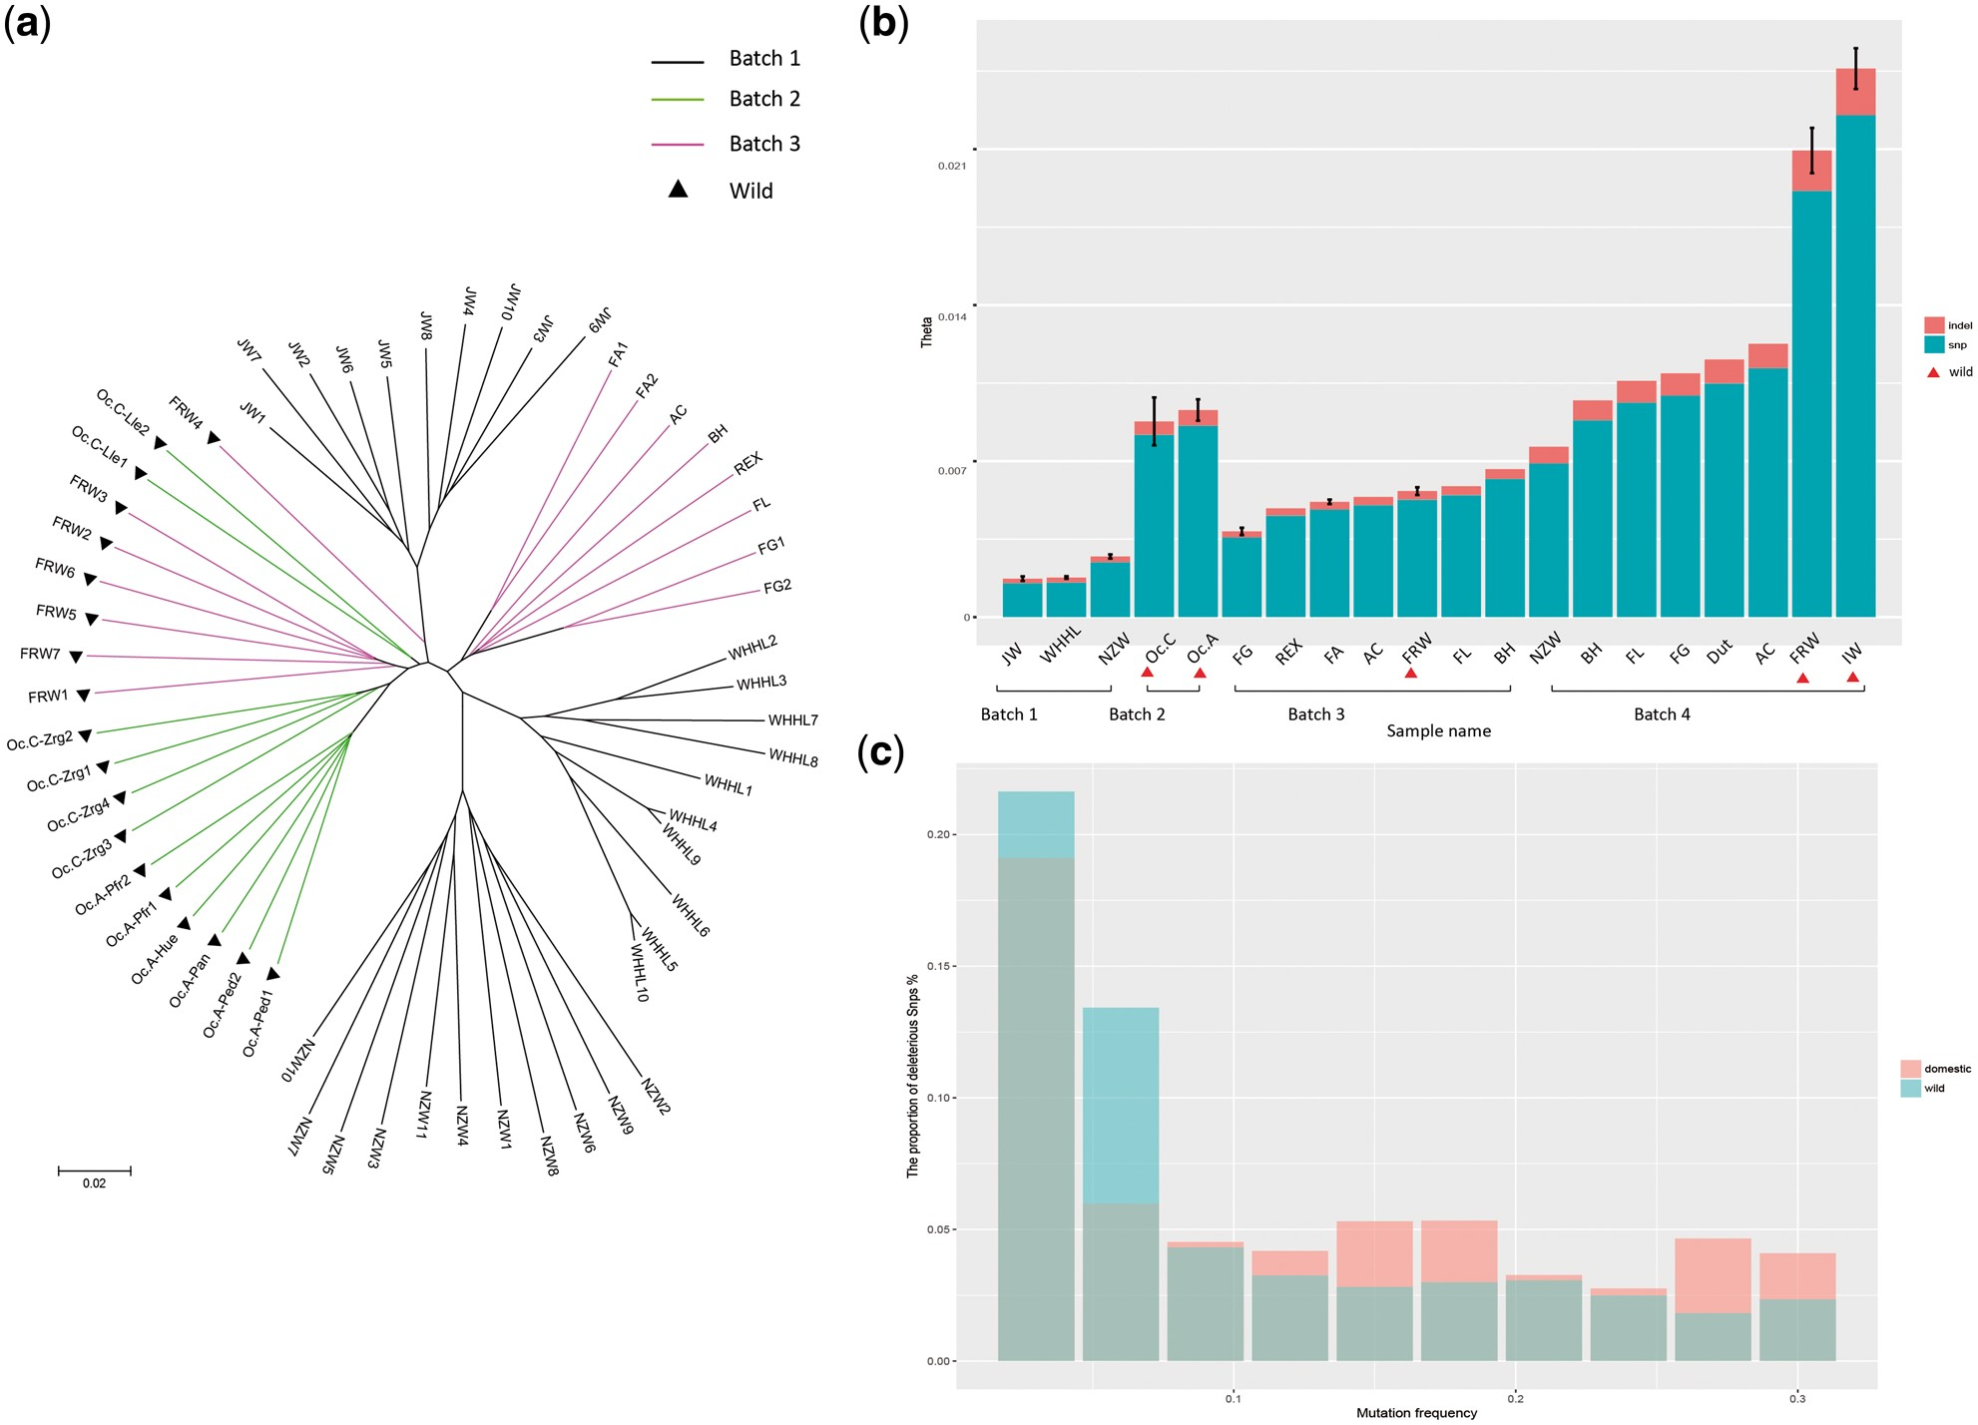
Figure 3. Analysis of rabbit domestication by data integration. (a) The Watterson’s theta based on SNPs and INDELs of ...
Notes:
Figure 3. Analysis of rabbit domestication by data integration. (a) The Watterson’s theta based on SNPs and INDELs of all samples. The wild samples are labeled by red triangles. For breeds with more than one samples, we calculated the standard deviation. (b) The phylogenetic tree of individual samples from Batches 1–3. Batches are indicated by different colors and the wild samples are labeled by black triangles. (c) The proportion of deleterious SNPs with different mutation allele frequency for domestic and wild samples, respectively.
Unless provided in the caption above, the following copyright applies to the content of this slide: © The Author(s) 2018. Published by Oxford University Press.This is an Open Access article distributed under the terms of the Creative Commons Attribution License (http://creativecommons.org/licenses/by/4.0/), which permits unrestricted reuse, distribution, and reproduction in any medium, provided the original work is properly cited.

