Slide 1
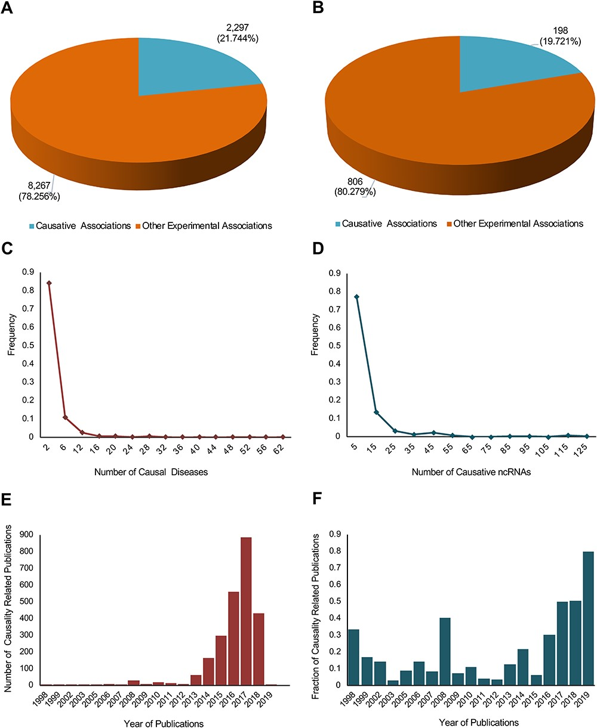
Figure 2 A statistical profile of the causality information of the new update of lncRNADisease. Pie charts show the ...
Notes:
Figure 2 A statistical profile of the causality information of the new update of lncRNADisease. Pie charts show the distribution of causal lncRNA–disease (A) and circRNA–disease (B) associations. In total, 2297 out of 10 564 lncRNA–disease associations and 198 out of 1004 circRNA–disease associations were identified to be causal. Distribution plots show the number of causal diseases for causative ncRNAs (C) and the number of causative ncRNAs for causal diseases (D). Bar plots show the number of causality related publications (E) and the fraction of causality related publications (F).
Unless provided in the caption above, the following copyright applies to the content of this slide: © The Author(s) 2020. Published by Oxford University Press. All rights reserved. For Permissions, please email: journals.permissions@oup.comThis is an Open Access article distributed under the terms of the Creative Commons Attribution License (http://creativecommons.org/licenses/by/4.0/), which permits unrestricted reuse, distribution, and reproduction in any medium, provided the original work is properly cited.

