Slide 1
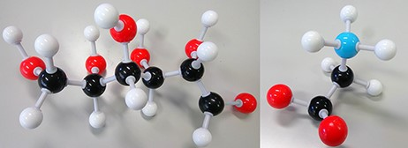
Figure 1. Disease biomarkers; Black, Grey, Red and Blue sphere colors correspond to C, H, O and N, respectively. (i) ...
Notes:
Figure 1. Disease biomarkers; Black, Grey, Red and Blue sphere colors correspond to C, H, O and N, respectively. (i) Diabetes biomarker (Glucose—C6H12O6). (ii) Encephalopathy biomarker (Glycine—C2H5NO2).
Unless provided in the caption above, the following copyright applies to the content of this slide: © The Author(s) 2021. Published by Oxford University Press.This is an Open Access article distributed under the terms of the Creative Commons Attribution License (http://creativecommons.org/licenses/by/4.0/), which permits unrestricted reuse, distribution, and reproduction in any medium, provided the original work is properly cited.

