Slide 1
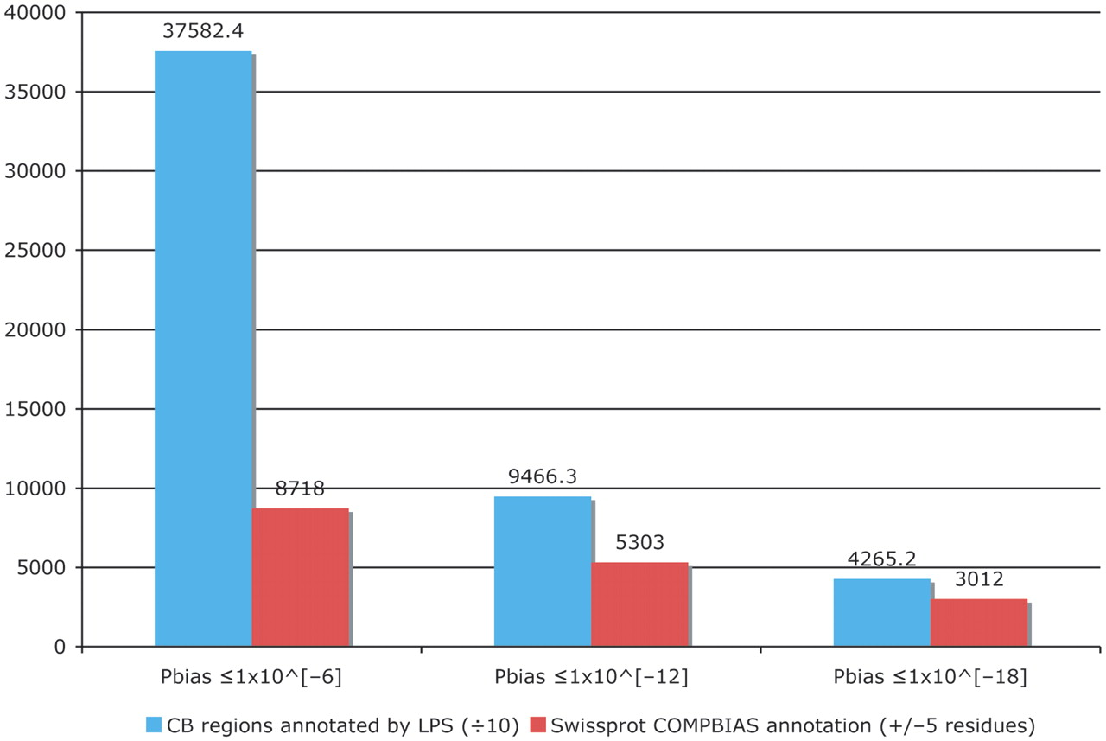
Figure 4. Column chart showing the augmentation of existing COMPBIAS annotations in UniProt, using the LPS algorithm. ...
Notes:
Figure 4. Column chart showing the augmentation of existing COMPBIAS annotations in UniProt, using the LPS algorithm. The blue column shows the number of CB regions annotated with the LPS-annotate algorithm, for three different P-value thresholds (10−6; 10−12; 10−18). The red columns are the existing UniProt COMPBIAS records that overlap the new LPS-annotate annotations (±5 residues at either end of the regions). The UniProt COMPBIAS records are intentionally limited in the UniProt/SwissProt databases to a few, more specific cases, such as homopolymeric runs, with up to one or two short interruptions in the run (26).
Unless provided in the caption above, the following copyright applies to the content of this slide: © The Author(s) 2011. Published by Oxford University Press.This is Open Access article distributed under the terms of the Creative Commons Attribution Non-Commercial License (http://creativecommons.org/licenses/by-nc/2.5), which permits unrestricted non-commercial use, distribution, and reproduction in any medium, provided the original work is properly cited.

