Slide 1
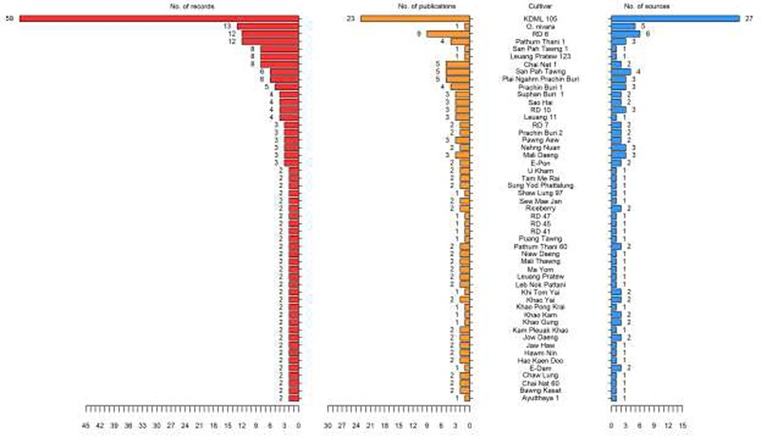
Figure 1. List of Thai rice cultivars in ThRSDB. The numbers of records (red), publications (yellow) and sources (blue) ...
Notes:
Figure 1. List of Thai rice cultivars in ThRSDB. The numbers of records (red), publications (yellow) and sources (blue) for each cultivar are illustrated. The cultivars with only one record are provided in Supplementary Table S1.
Unless provided in the caption above, the following copyright applies to the content of this slide: © The Author(s) 2020. Published by Oxford University Press.This is an Open Access article distributed under the terms of the Creative Commons Attribution License (http://creativecommons.org/licenses/by/4.0/), which permits unrestricted reuse, distribution, and reproduction in any medium, provided the original work is properly cited.

