Slide 1
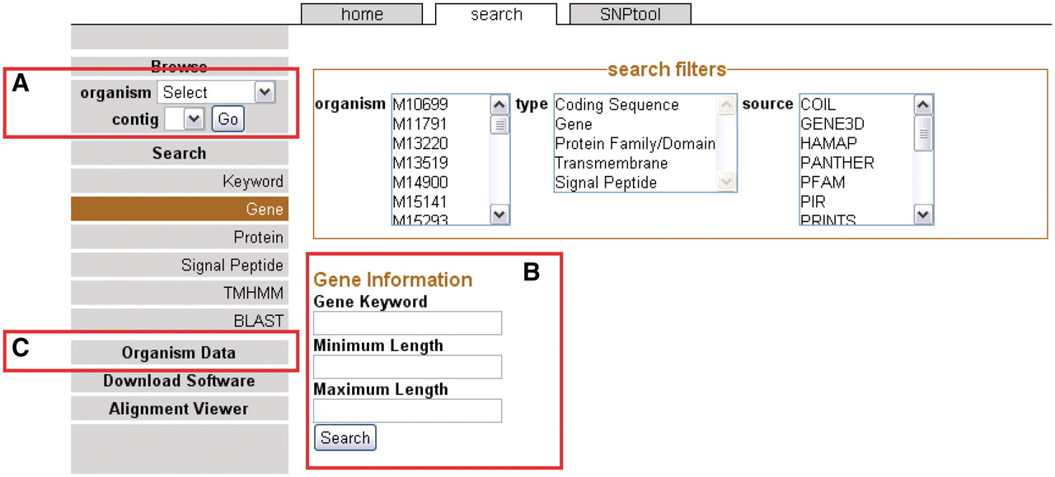
Figure 1. The front page sidebar. The sidebar provides access to the genome browser, search functions and metadata. (A) ...
Notes:
Figure 1. The front page sidebar. The sidebar provides access to the genome browser, search functions and metadata. (A) To browse, users can select a genome and a contig to proceed to the GBrowse interface. (B) To search, a user can supply a keyword or can choose to search via one of several search items. (C) Genomic metadata is available via the Organism Data link (Supplementary Table S1). A link is provided to the alignment data page.
Unless provided in the caption above, the following copyright applies to the content of this slide: © The Author(s) 2011. Published by Oxford University Press.This is Open Access article distributed under the terms of the Creative Commons Attribution Non-Commercial License (http://creativecommons.org/licenses/by-nc/2.5), which permits unrestricted non-commercial use, distribution, and reproduction in any medium, provided the original work is properly cited.

