Slide 1
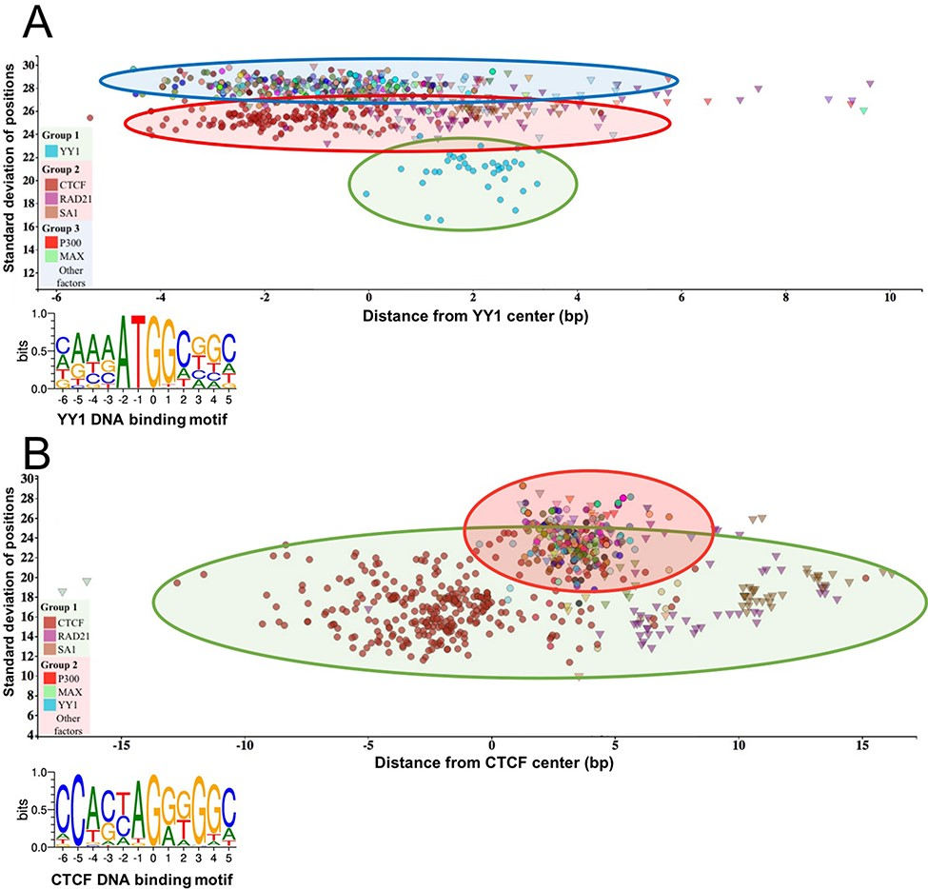
Figure 3 The standard deviation of the distances of the peak summit and binding site centers shows the DNA–protein ...
Notes:
Figure 3 The standard deviation of the distances of the peak summit and binding site centers shows the DNA–protein proximity. Each scatter represents average summit position from a single ChIP-seq experiment. The X-axis represents the distance from the binding site center, which position is marked by `0’ in the binding motif logo. The standard deviation of the summit-motif center distances is shown on the Y-axis. (A) The proteins, which show interaction with YY1 binding sites, are arranged in three groups. The lowest SD (between 16 and 22) belongs to YY1 protein, which binds directly to the YY1 DNA binding motifs. In the second layer, CTCF and cohesin subunit (RAD21, SA1) ChIP-seq signals are the most common. The third group with high SD, above 27, represents a diverse population, which consists of ChIP-seq experiments with different protein targets and more than 1000 overlapping peaks. The P300 and MAX proteins from Group 3 are labeled by red and green colors, respectively. The figure was slightly modified and adapted from ChIPSummitDB website: http://summit.med.unideb.hu/summitdb/motif_view.php?maxid=10000&minid=1&mnelem=1000&mxelem=120000&motive=YY1. (B) In the case of the CTCF binding sites, only two layers can be distinguished. In the first group, the directly interacting CTCF, RAD21 and SA1 proteins can be found, while the YY1, P300, MAX and other proteins are presented in the second group. Please note that the relative position of the YY1 and CTCF proteins to each other is the same on both plots. The figure was slightly modified and adapted from ChIPSummitDB website: http://summit.med.unideb.hu/summitdb/motif_view.php?maxid=10000&minid=1&mnelem=5000&mxelem=120000&motive=CTCF
Unless provided in the caption above, the following copyright applies to the content of this slide: © The Author(s) 2020. Published by Oxford University Press.This is an Open Access article distributed under the terms of the Creative Commons Attribution License (http://creativecommons.org/licenses/by/4.0/), which permits unrestricted reuse, distribution, and reproduction in any medium, provided the original work is properly cited.

