Slide 1
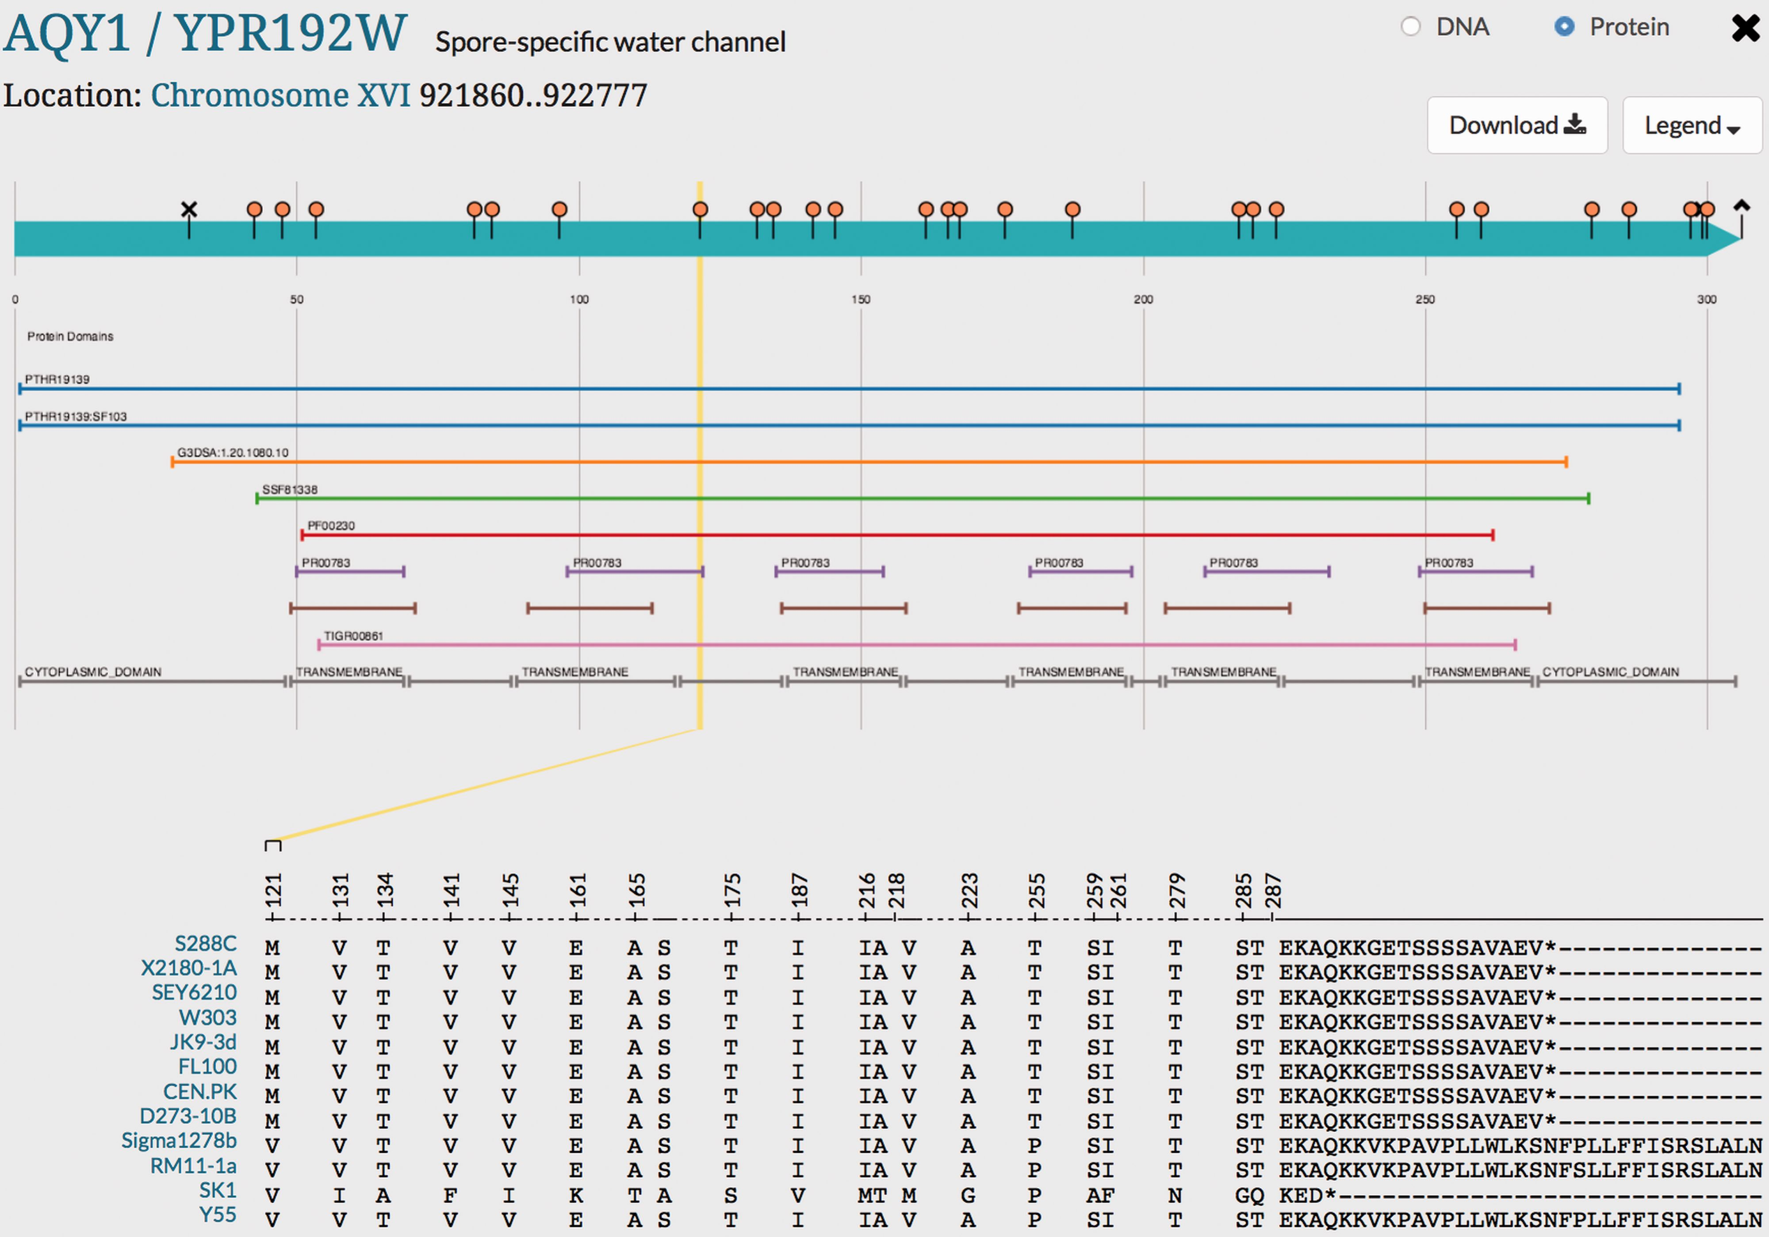
Figure 4. Visualization of genetic variation within AQY1 gene across alternative reference strains in SGD. Variations ...
Notes:
Figure 4. Visualization of genetic variation within AQY1 gene across alternative reference strains in SGD. Variations within AQY1 among 11 alternative strains and the S288C reference strain are depicted in the SGD Variant Viewer. Non-synonymous mutations and deletions/insertions with their location information in AQY1 are shown in the viewer. We can see that AQY1 is conserved in most laboratory strains. SK1 shows the most non-synonymous mutations relative to the S288C reference unlike the other strains. There are two common mutations that appear in four strains Sigma1278b, RM11-1a, SK1 and Y55: V121 (guided in a yellow line in the viewer) and P255. SK1 has a shorter C-terminus than other strains whereas Sigma1278b, RM11-1a and Y55 have longer C-termini than the eight laboratory strains. Other than the C-terminus and two mutations (V121 and P255), Sigma1278b, RM11-1a and Y55 show conserved amino acids with the eight laboratory strains unlike SK1.
Unless provided in the caption above, the following copyright applies to the content of this slide: © The Author(s) 2016. Published by Oxford University Press. This is an Open Access article distributed under the terms of the Creative Commons Attribution License ( http://creativecommons.org/licenses/by/4.0/ ), which permits unrestricted reuse, distribution, and reproduction in any medium, provided the original work is properly cited.

