Slide 1
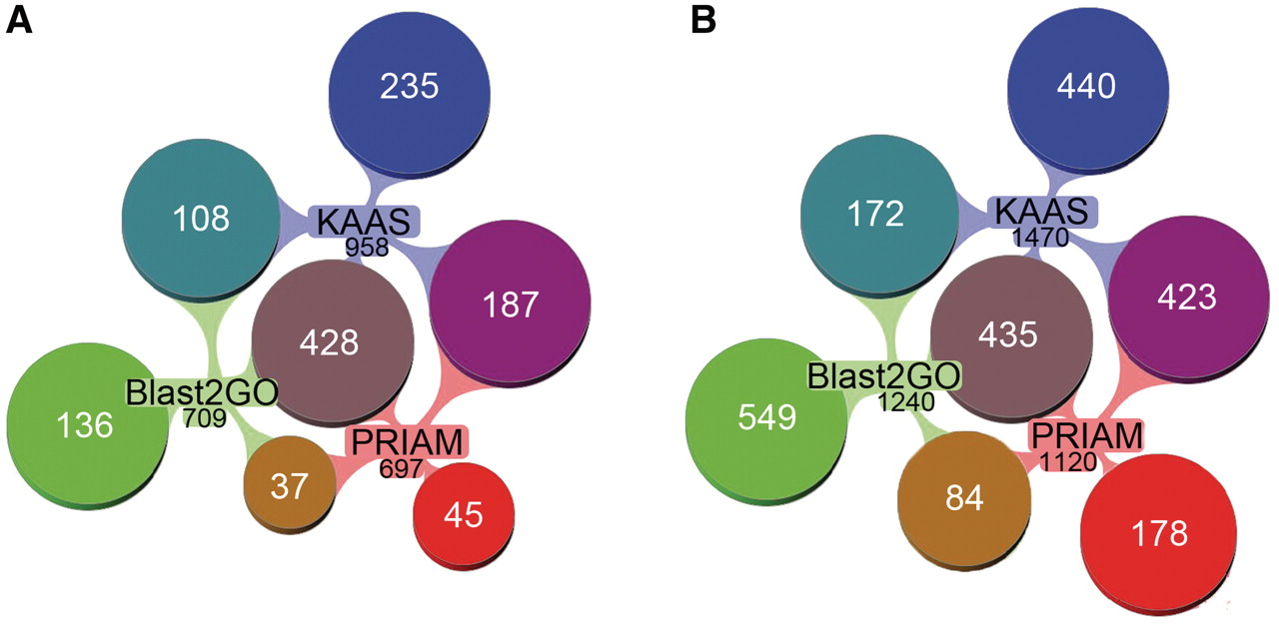
Figure 3. Comparison of the EC annotation by different methods in AcypiCyc. (A) Reaction annotation by EC methods. ...
Notes:
Figure 3. Comparison of the EC annotation by different methods in AcypiCyc. (A) Reaction annotation by EC methods. Venn-diagrams showing the number of reactions (total of 1176) identified in the metabolic reconstructions using data from the different annotation methods [PRIAM, KAAS (two methods), Blast2GO-EC], the total number of reactions annotated by each method is specified in black below the method name, while specified in white is the number of unique or shared reactions among annotations. (B) Gene annotation by EC methods. Venn-diagrams showing the number of genes (total of 2281) annotated using the different methods [colour code for annotations as in (A)]. Note: multiple genes may catalyse a single reaction. This figure was generated using Aduna Cluster Map - http://www.aduna-software.com/technology/clustermap.
Unless provided in the caption above, the following copyright applies to the content of this slide: © The Author(s) 2011. Published by Oxford University Press.This is Open Access article distributed under the terms of the Creative Commons Attribution Non-Commercial License (http://creativecommons.org/licenses/by-nc/2.5), which permits unrestricted non-commercial use, distribution, and reproduction in any medium, provided the original work is properly cited.

