Slide 1
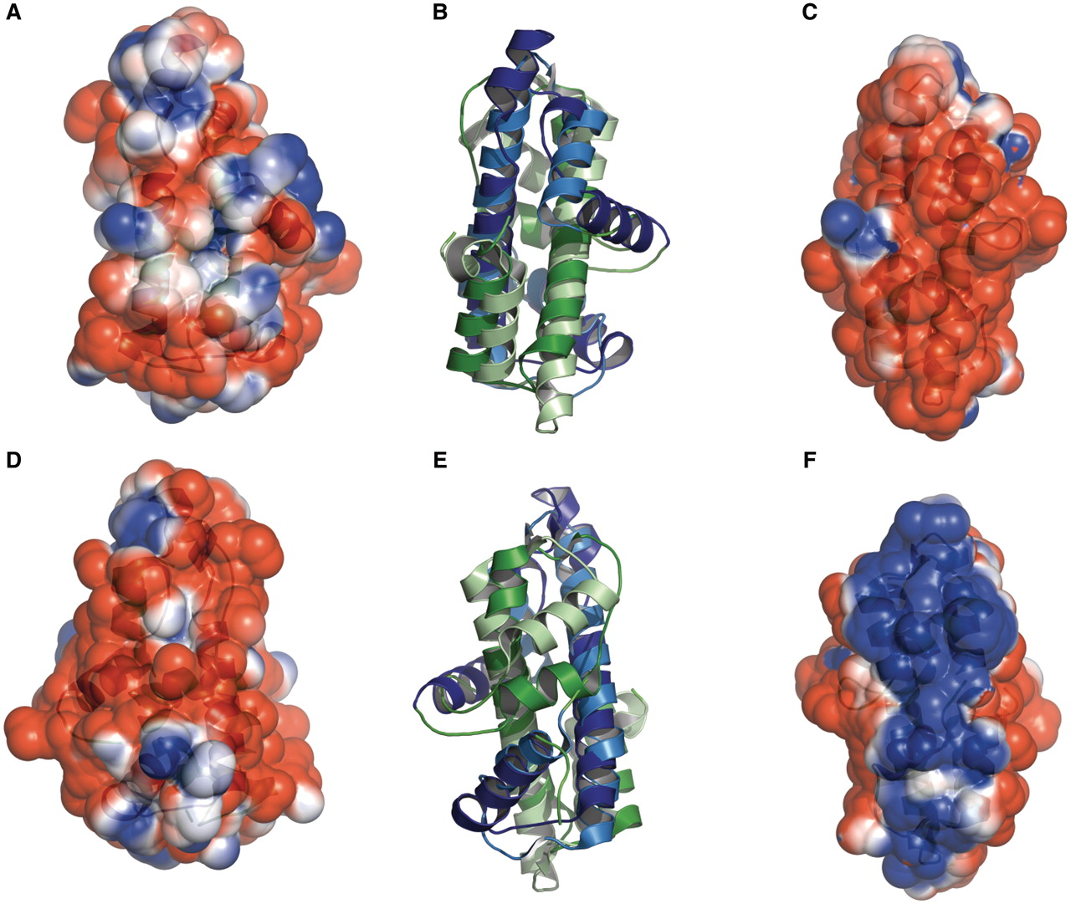
Figure 3. Histone-like folds in A. aeolicus and M. kandleri. Protein Aq_328 from the hyperthermophilic bacterium A. ...
Notes:
Figure 3. Histone-like folds in A. aeolicus and M. kandleri. Protein Aq_328 from the hyperthermophilic bacterium A. aeolicus (PDB:1R4V) and archaeal histone from M. kandleri (PDB:1F1E) have two histone like folds. These are colored as dark blue and dark green (for 1R4V) and light blue and light green (for 1F1E). The electrostatic surface potential ranges from +2 kTe−1 (blue) to −2 kTe−1(red). (A) and (D) the front and back views, respectively, of the electrostatic surface potential of Protein Aq_328. (B) and (E) superimposed structures of protein Aq_328 and the archaeal histone from M. kandleri. (C) and (F) the front and back views, respectively, of the electrostatic surface potential of the archaeal histone from M. kandleri. The figures were generated with PyMOL (49) and the APBS plug-in for PyMOL (50).
Unless provided in the caption above, the following copyright applies to the content of this slide: © The Author(s) 2011. Published by Oxford University Press on behalf of the National Institutes of Health.This is an Open Access article distributed under the terms of the Creative Commons Attribution Non-Commercial License (http://creativecommons.org/licenses/by-nc/3.0), which permits unrestricted non-commercial use, distribution, and reproduction in any medium, provided the original work is properly cited.

